Slide 1




Navigating Uncertainty: Neural Mechanisms of Probabilistic Foraging in Mongolian Gerbils
Master’s Thesis Defense
Vishal Kannan
Supervisor: Prof. Dr. Max Happel
Examiners
Prof. Dr. Max Happel
Prof. Dr. Frank Ohl
Notes:
Write questions and convey why it is important to study decision making under uncertainty?
Next slide go to lit review and say what has been done already and what is missing?
We often must choose whether to try something new (exploration) or stick with a proven strategy (exploitation). Balancing this trade-off is important for survival and growth across species because, without exploration, we would perseverate with the same strategies and never discover better options. Which brain mechanisms are responsible for our ability to make these decisions?
Humans are remarkably curious, and that is useful in helping us to learn about new environments and possibilities. But curiosity killed the cat, they say, and it also carries with it substantial potential risks and costs for us. Statisticians, engineers and economists have long considered ways of balancing the costs and benefits of exploration.

Slide 2

Should I stay or should I go?
Exploitation
Exploration
Navigating Uncertainty: Neural Mechanisms of Probabilistic Foraging in Mongolian Gerbils
Master’s Thesis
by
Vishal Kannan
Supervisor: Prof. Dr. Max Happel
Notes:
Start with a humor about should I stay or should I go?

Slide 3

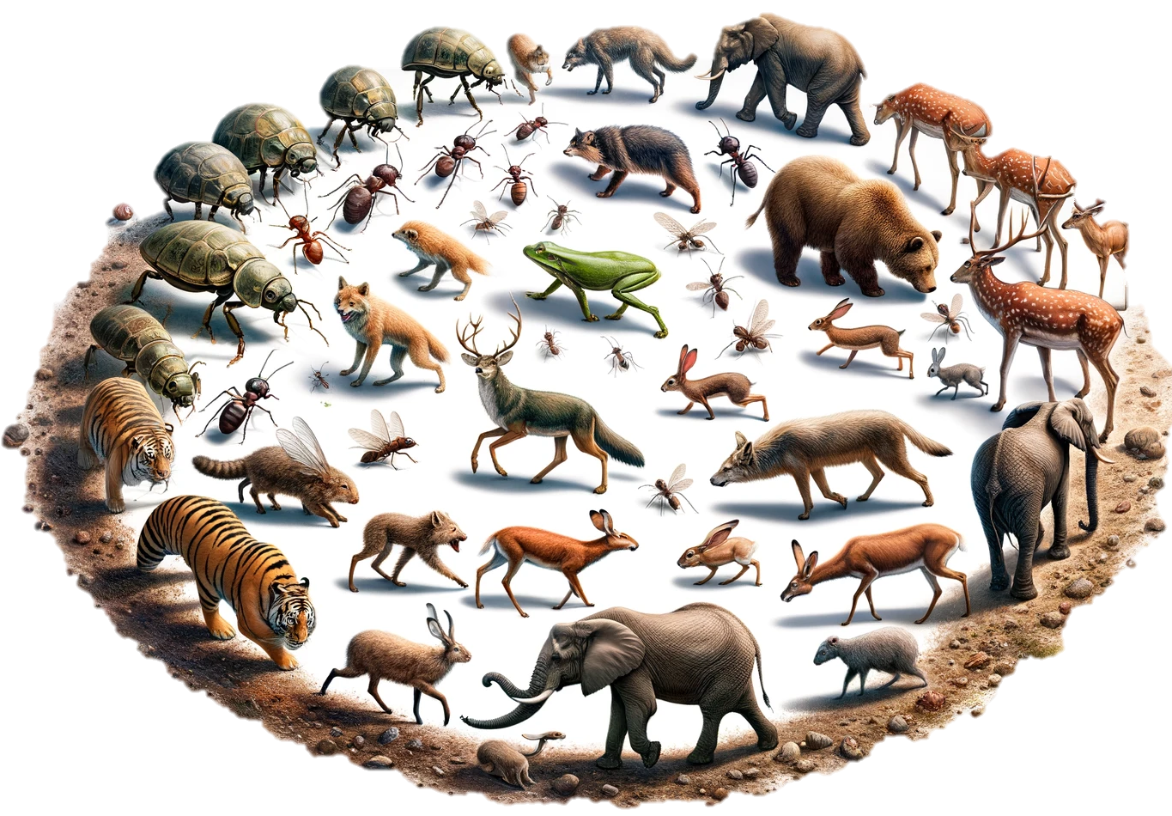
Okay, let’s start it easy
Should I choose for a new dish in the menu or go for my usual one?
Should I take the familiar route to work or try a new path today?
Decision making in uncertain situations
Exploration-exploitation dilemma
Adaptive decision making
Key aspect of survival across species
What are the brain mechanisms that guide this critical behaviour?
Notes:
Write questions and convey why it is important to study decision making under uncertainty?
Next slide go to lit review and say what has been done already and what is missing?
We often must choose whether to try something new (exploration) or stick with a proven strategy (exploitation). Balancing this trade-off is important for survival and growth across species because, without exploration, we would perseverate with the same strategies and never discover better options. Which brain mechanisms are responsible for our ability to make these decisions?
Humans are remarkably curious, and that is useful in helping us to learn about new environments and possibilities. But curiosity killed the cat, they say, and it also carries with it substantial potential risks and costs for us. Statisticians, engineers and economists have long considered ways of balancing the costs and benefits of exploration.

Slide 4


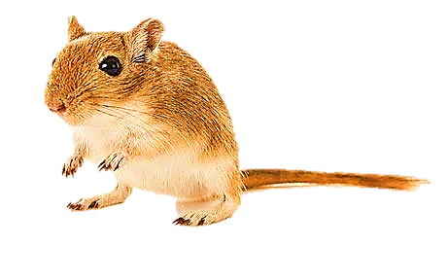
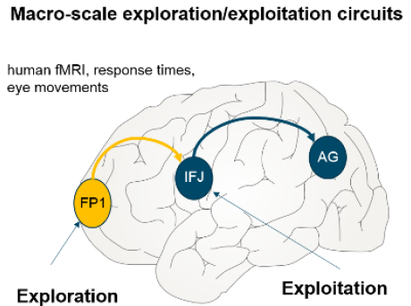
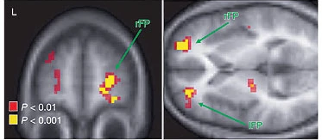
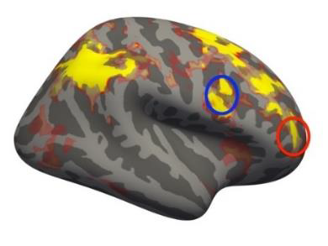
Foraging behaviour and attentional resource allocation in the brain
Foraging behaviour →Exploration-exploitation dilemma
Cognitive balancing act
Attentional resource allocation problem in the brain
What brain area(s) is mainly involved in such exploratory resource allocation?
Current situation
Potential risks
Insights from human and monkey studies
Neural substrates for exploratory behaviour
Frontopolar cortex in humans – Gambling studies (Daw et al., 2006 ) (Raja Beharelle et al., 2015)
aPFC in Monkeys (Mansouri et al., 2015)
Notes:
Write questions and convey why it is important to study decision making under uncertainty?
Next slide go to lit review and say what has been done already and what is missing?
We often must choose whether to try something new (exploration) or stick with a proven strategy (exploitation). Balancing this trade-off is important for survival and growth across species because, without exploration, we would perseverate with the same strategies and never discover better options. Which brain mechanisms are responsible for our ability to make these decisions?
Humans are remarkably curious, and that is useful in helping us to learn about new environments and possibilities. But curiosity killed the cat, they say, and it also carries with it substantial potential risks and costs for us. Statisticians, engineers and economists have long considered ways of balancing the costs and benefits of exploration.

Slide 5
Foraging behaviour and attentional resource allocation in the brain
Foraging behaviour →Exploration-exploitation dilemma
Cognitive balancing act
Attentional resource allocation problem in the brain
What brain area(s) is mainly involved in such exploratory resource allocation?
Current situation
Potential risks
Insights from human and monkey studies
Lesion studies → Potential causal role (Mansouri et al., 2015)
Neural substrates for exploratory behaviour
Frontopolar cortex in humans (Daw et al., 2006 ) (Raja Beharelle et al., 2015)
aPFC in Monkeys (Mansouri et al., 2015)
Pre-decisional increase in frontal activity
Increased dendritic spine density (Jacobs et al., 2001 )
Potential neurocognitive circuit for the exploratory resource allocation ?
But is it the same in rodents?
Notes:
Write questions and convey why it is important to study decision making under uncertainty?
Next slide go to lit review and say what has been done already and what is missing?
We often must choose whether to try something new (exploration) or stick with a proven strategy (exploitation). Balancing this trade-off is important for survival and growth across species because, without exploration, we would perseverate with the same strategies and never discover better options. Which brain mechanisms are responsible for our ability to make these decisions?
Humans are remarkably curious, and that is useful in helping us to learn about new environments and possibilities. But curiosity killed the cat, they say, and it also carries with it substantial potential risks and costs for us. Statisticians, engineers and economists have long considered ways of balancing the costs and benefits of exploration.

Slide 6
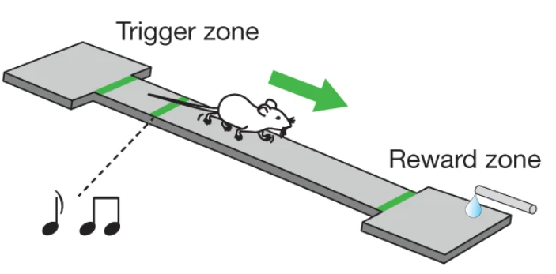
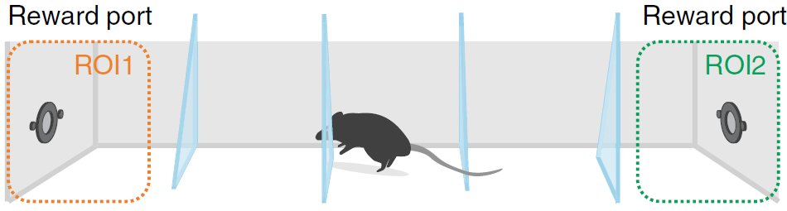
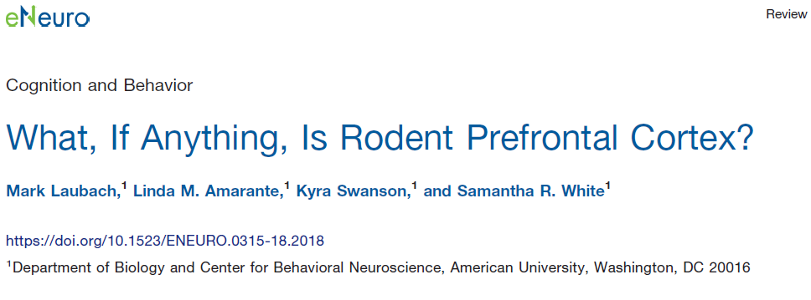
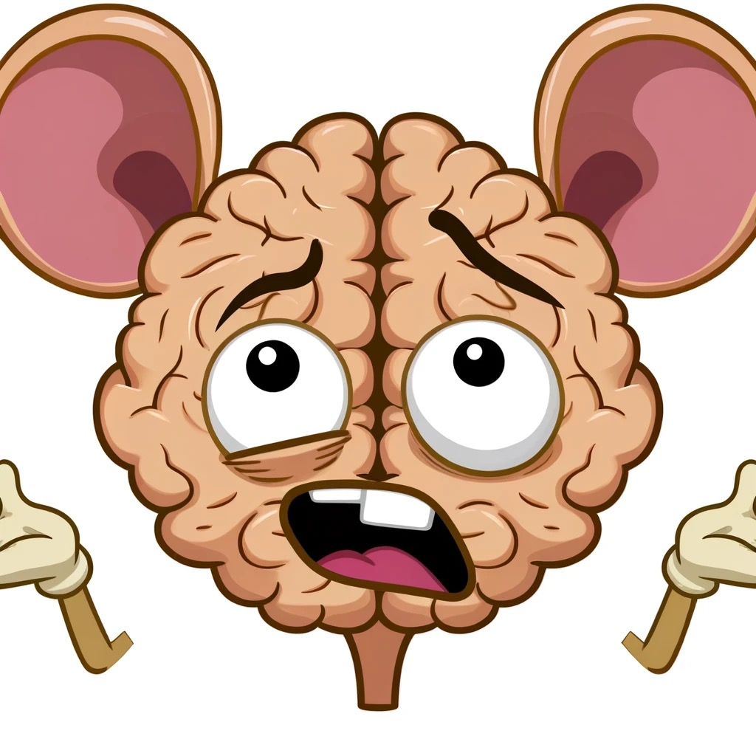
Inconsistencies in rodent studies
Medial prefrontal cortex (mPFC) → exploratory behaviour
Inconsistencies in nomenclature – explain it better
Challenging to draw direct comparisons with primate studies
(Kvitsiani et al., 2013)
(Lottem et al., 2018; Vertechi et al., 2020)
Medial prefrontal cortex (mPFC)
anterior cingulate cortex (ACC)
orbitofrontal cortex (OFC)
Pre-limbic area
We need a proper analogue of human frontopolar cortex (anterior PFC) in rodents
Information about layer dependent processing in frontal cortex is missing
Notes:
Write questions and convey why it is important to study decision making under uncertainty?
Next slide go to lit review and say what has been done already and what is missing?
We often must choose whether to try something new (exploration) or stick with a proven strategy (exploitation). Balancing this trade-off is important for survival and growth across species because, without exploration, we would perseverate with the same strategies and never discover better options. Which brain mechanisms are responsible for our ability to make these decisions?
Humans are remarkably curious, and that is useful in helping us to learn about new environments and possibilities. But curiosity killed the cat, they say, and it also carries with it substantial potential risks and costs for us. Statisticians, engineers and economists have long considered ways of balancing the costs and benefits of exploration.

Slide 7
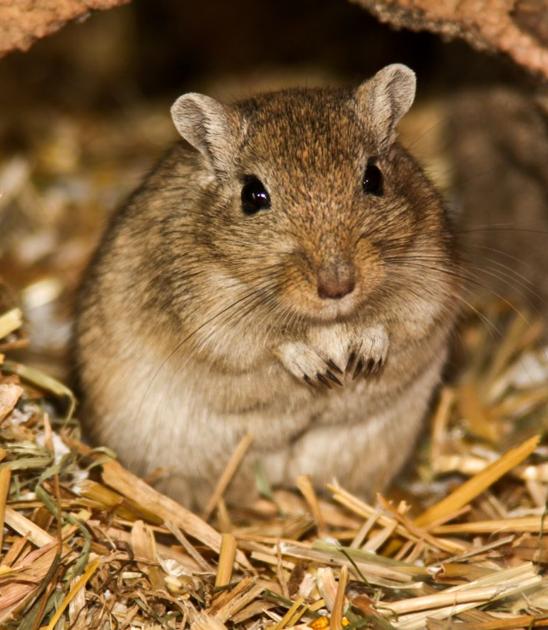
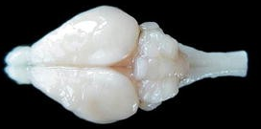
Inconsistencies in rodent studies
Medial prefrontal cortex (mPFC) → exploratory behaviour
Inconsistencies in nomenclature – no consensus in naming and anatomical boundaries
Medial prefrontal cortex (mPFC)
anterior cingulate cortex (ACC)
(Kvitsiani et al., 2013)
(Lottem et al., 2018; Vertechi et al., 2020)
Challenging to draw direct comparisons with primate studies
Exploratory behaviour is observed in rodents
orbitofrontal cortex (OFC)
Pre-limbic area
We need a proper analogue of human frontopolar cortex (anterior PFC) in rodents
Mongolian gerbil (Meriones unguiculatus) – desert rodents
Frontal region A (FrA) – analogous to Frontopolar cortex in humans
Gerbil anatomical atlas - avoids usage of previous nomenclature
Radtke-Schuller et al., 2016
Notes:
Write questions and convey why it is important to study decision making under uncertainty?
Next slide go to lit review and say what has been done already and what is missing?
We often must choose whether to try something new (exploration) or stick with a proven strategy (exploitation). Balancing this trade-off is important for survival and growth across species because, without exploration, we would perseverate with the same strategies and never discover better options. Which brain mechanisms are responsible for our ability to make these decisions?
Humans are remarkably curious, and that is useful in helping us to learn about new environments and possibilities. But curiosity killed the cat, they say, and it also carries with it substantial potential risks and costs for us. Statisticians, engineers and economists have long considered ways of balancing the costs and benefits of exploration.

Slide 8
In this study
Neural underpinnings of decision-making in uncertain environments using Mongolian gerbils as a rodent model
Radtke-Schuller et al., 2016
Adapted an established probabilistic foraging paradigm → exploration-exploitation dilemma
Established chronic electrophysiological techniques to study layer processing
(Lottem et al., 2018)
(Ohl et al., 1999, Happel et al., 2010, 2014) (Deane et al., 2020; Happel et al., 2014; Zempeltzi et al., 2020) (Brunk et al., 2019)
Potential to serve as a crucial model for investigating similar processes in complex beings, including humans
Now, let’s get into some details! (Disclaimer: A lot of neuroscientific jargons will be thrown at you!)

Slide 9
Mongolian gerbils as a rodent model for exploratory behaviour
Mongolian gerbil (Meriones unguiculatus) – desert rodents
Frontal region A (FrA) – analogous to Frontopolar cortex in humans
Established electrophysiology techniques to study layer processing
(Ohl et al., 1999, Happel et al., 2010, 2014) (Deane et al., 2020; Happel et al., 2014; Zempeltzi et al., 2020) (Brunk et al., 2019)
Radtke-Schuller et al., 2016
In this study
Adapted an established probabilistic foraging paradigm → exploration-exploitation dilemma
Neural underpinnings of decision-making in uncertain environments using Mongolian gerbils as a rodent model
A crucial model for investigating similar processes in complex beings, including humans
Now, let’s get into some details! (Disclaimer: A lot of neuroscientific jargons will be thrown at you!)
Notes:
Write questions and convey why it is important to study decision making under uncertainty?
Next slide go to lit review and say what has been done already and what is missing?
We often must choose whether to try something new (exploration) or stick with a proven strategy (exploitation). Balancing this trade-off is important for survival and growth across species because, without exploration, we would perseverate with the same strategies and never discover better options. Which brain mechanisms are responsible for our ability to make these decisions?
Humans are remarkably curious, and that is useful in helping us to learn about new environments and possibilities. But curiosity killed the cat, they say, and it also carries with it substantial potential risks and costs for us. Statisticians, engineers and economists have long considered ways of balancing the costs and benefits of exploration.

Slide 10
Objectives

Slide 11
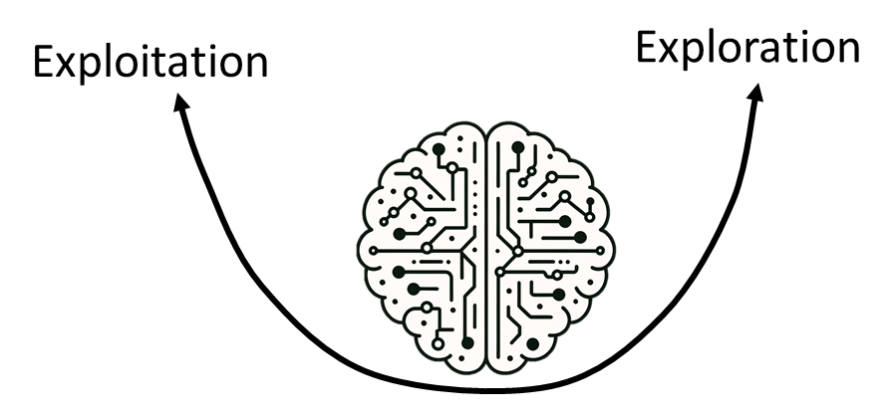
Objectives
Neuronal circuit functions in frontal cortex – exploitative vs explorative strategies

Slide 12
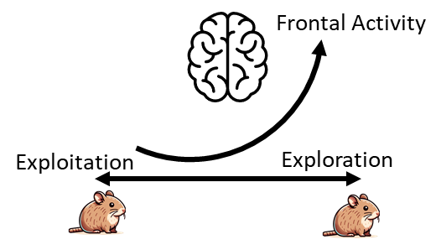
Objectives
frontal activity before an exploratory decision
Neuronal circuit functions in frontal cortex – exploitative vs explorative strategies

Slide 13
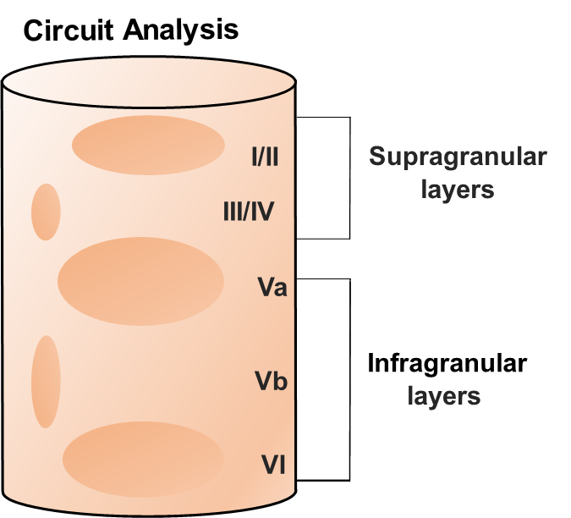
Objectives
Neuronal circuit functions in frontal cortex – exploitative vs explorative strategies
Layer-dependent processing
frontal activity before patch leaving decision

Slide 14
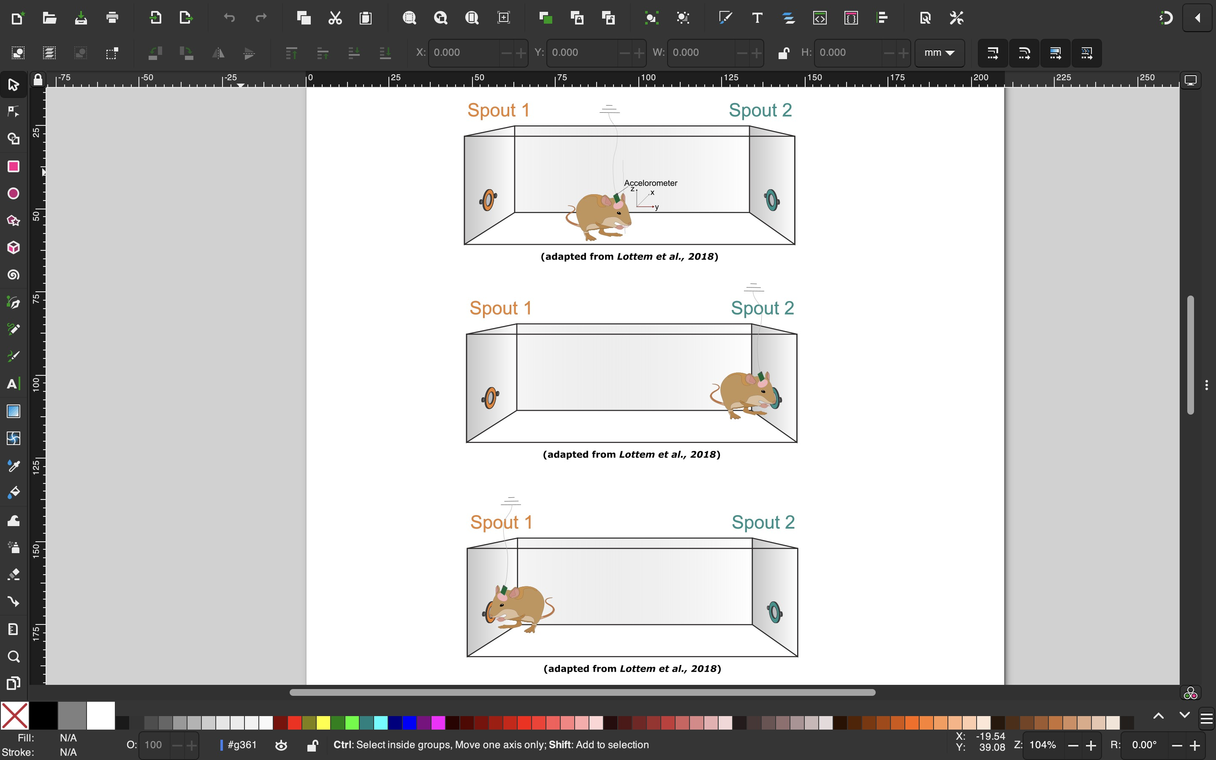

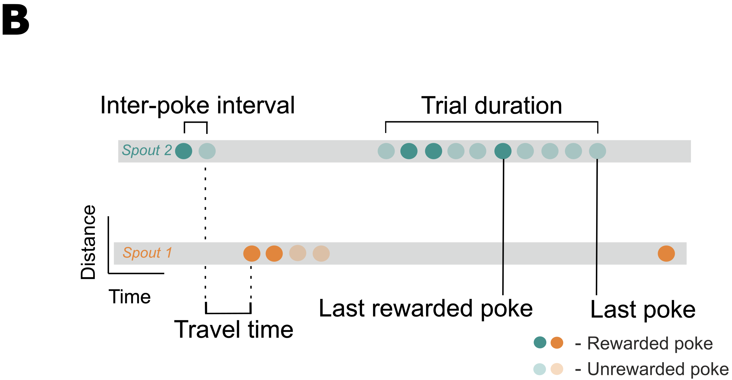
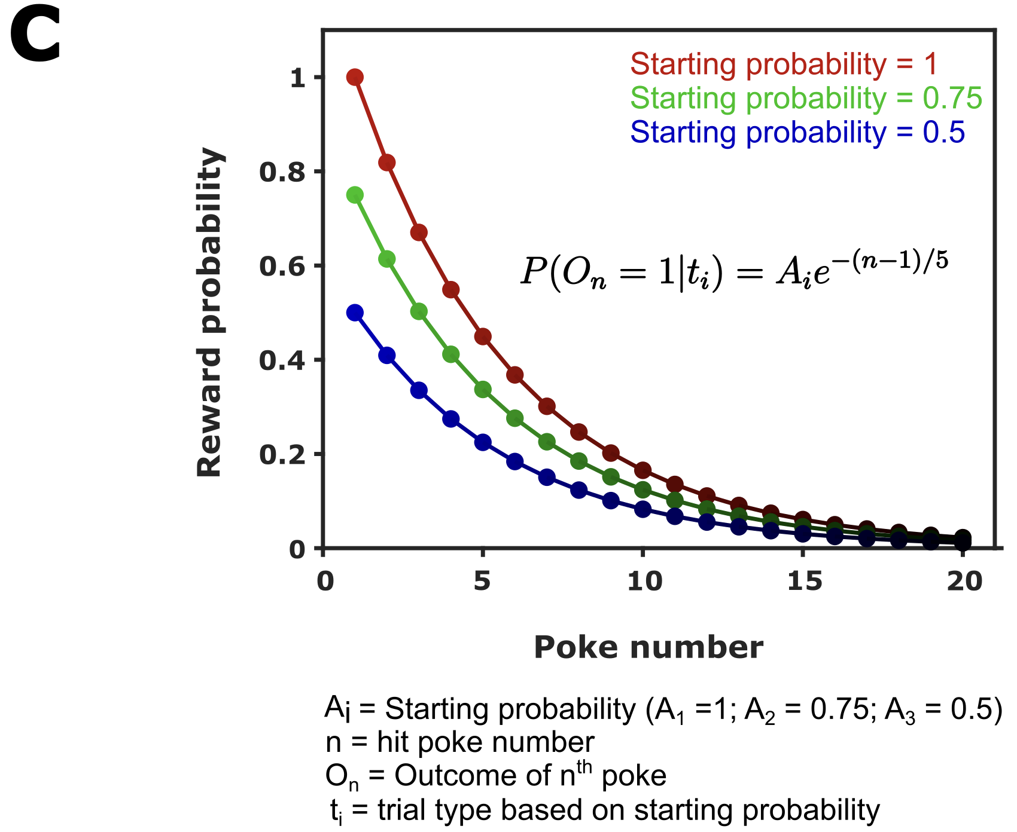


The probabilistic foraging task
Steps towards introducing the uncertainty
1. Exponential decay of reward probability
2. Dynamic starting reward probability
?

Slide 15

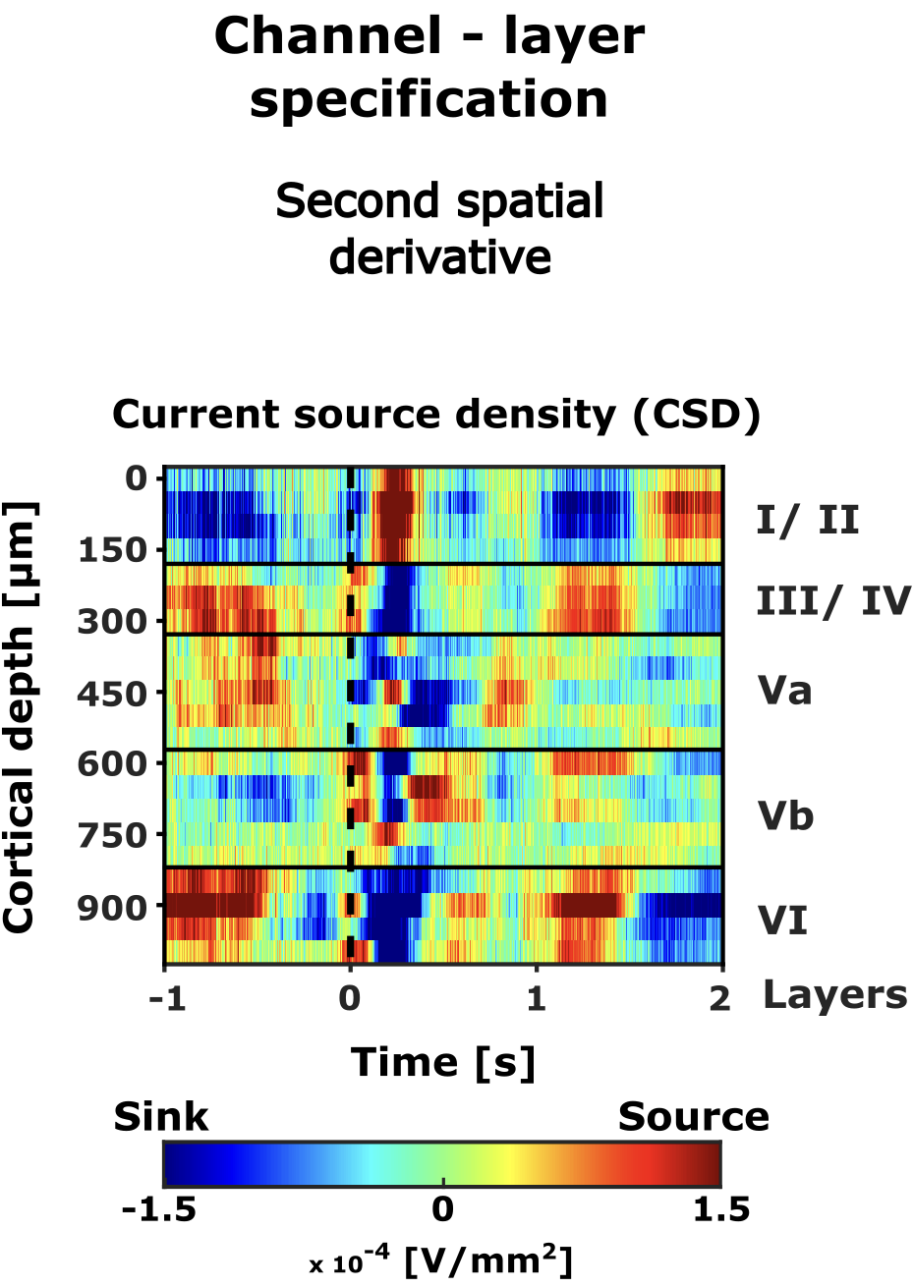
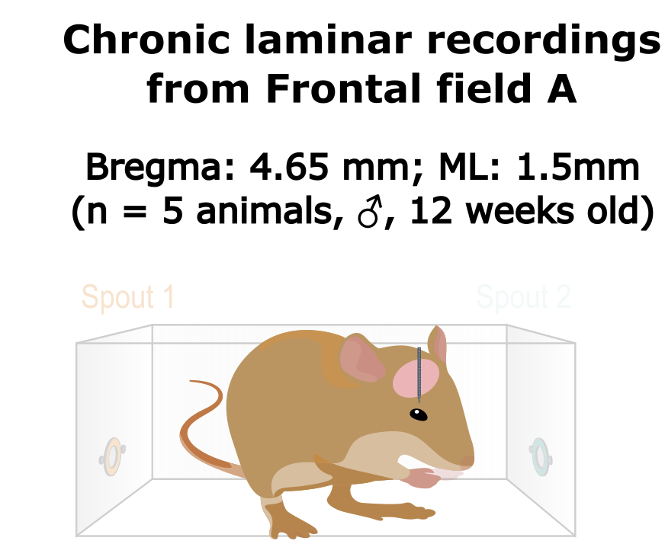
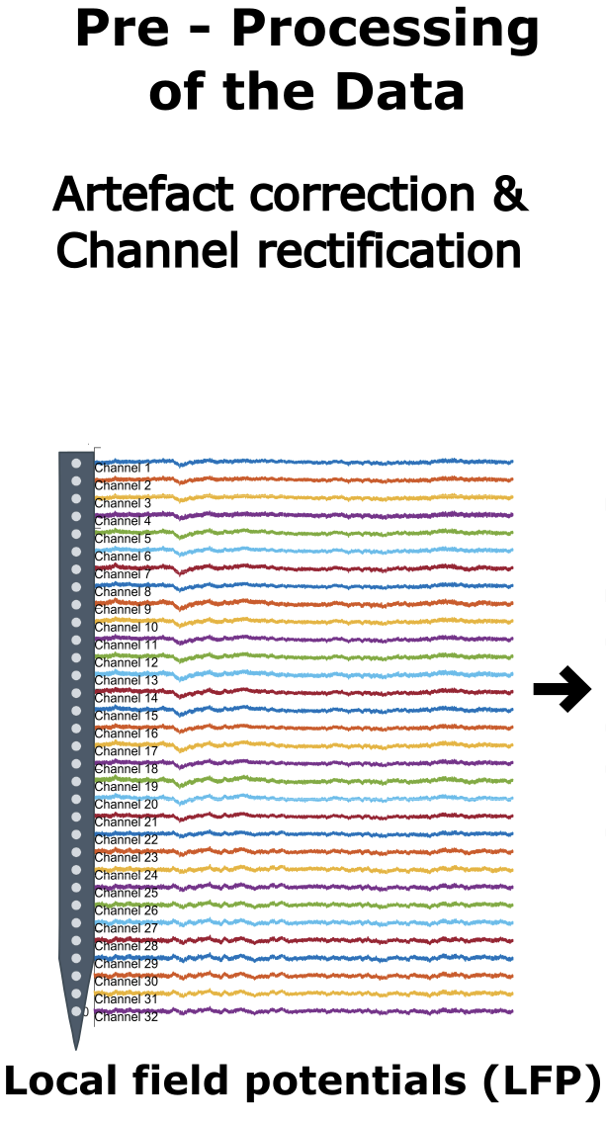
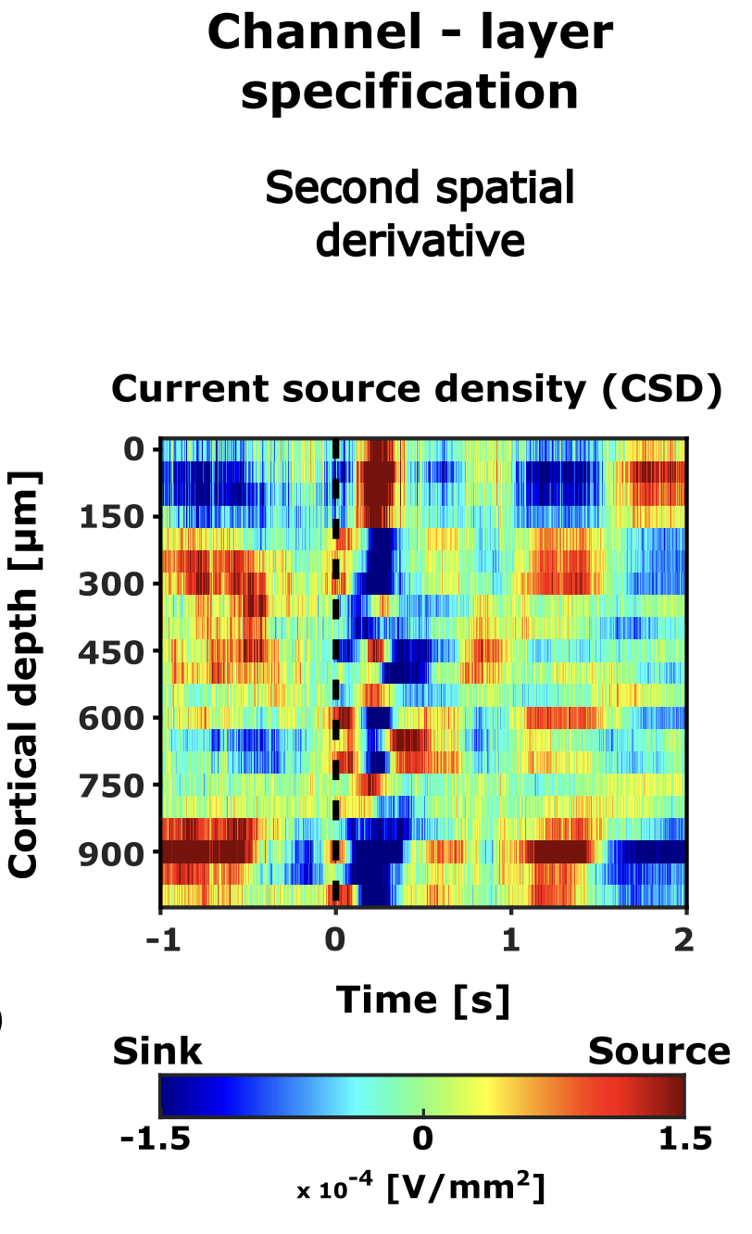
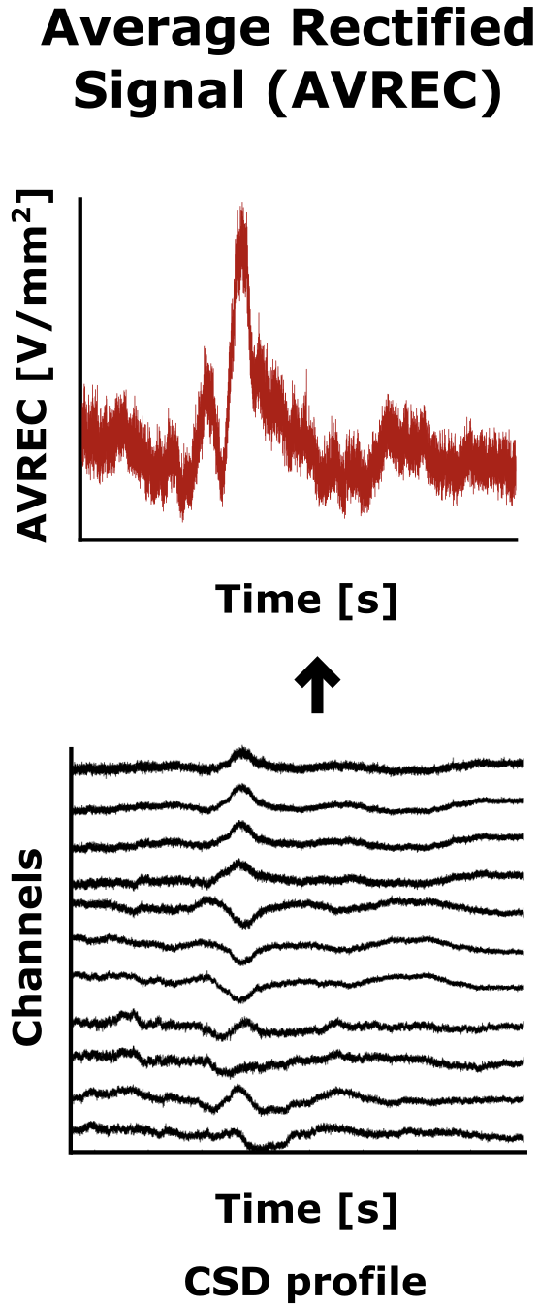

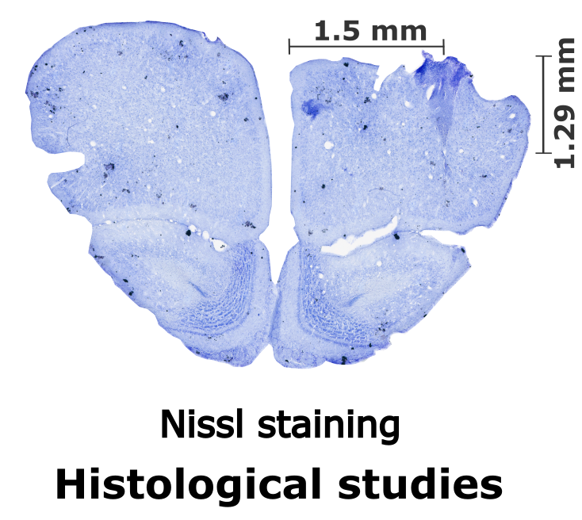
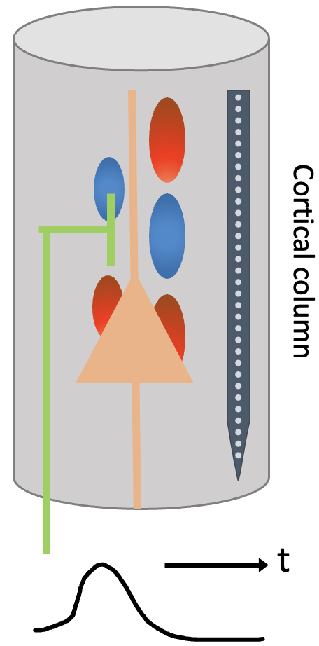

How did we study this?
Overall frontal activity
Average across layers
Average across channels
Cortical column
Integration
Cylinder
t

Slide 16
How did we study this?
Overall frontal activity
Average across layers
Notes:
CSD profile from laminar recordings is a refined measure that identifies regions of synaptic input (sinks) and output (sources), thus providing a detailed map of electrical current flow through the cortical layers, which is crucial for understanding neuronal circuitry at a mesoscopic scale. They represent synaptic population activities with high spatial and temporal precision, uncovering the functional micro-circuitry of the cortex (Happel et al., 2010).

Slide 17
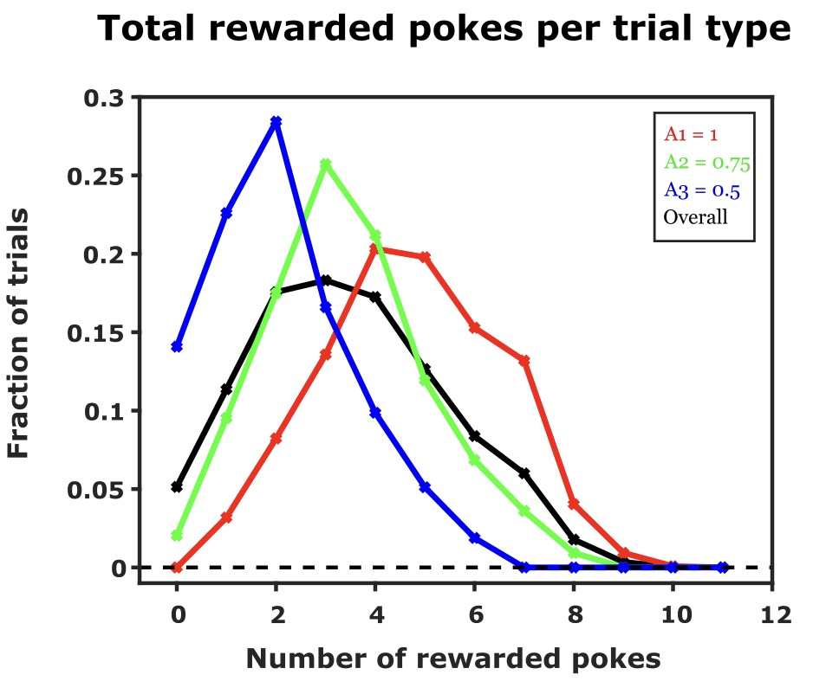
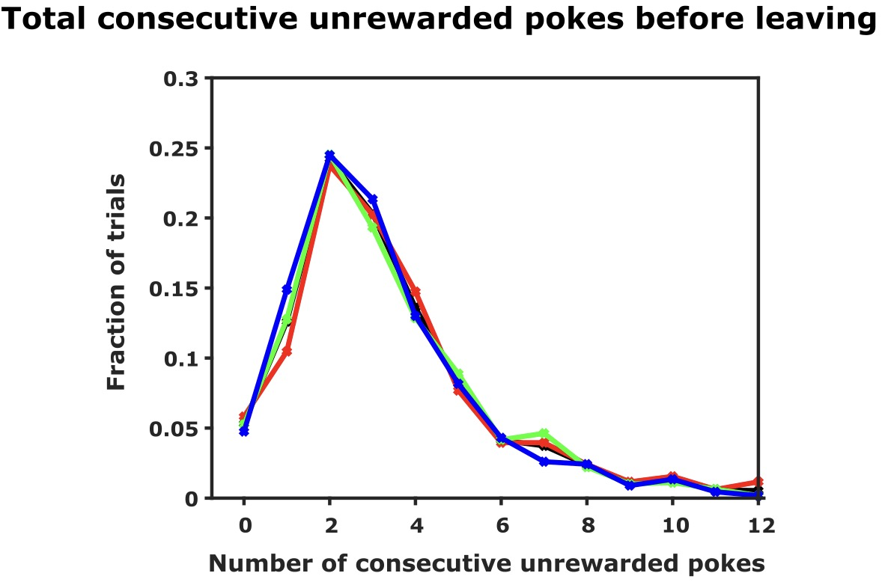

Animals make inference-based decision
The spout leaving behaviour
Total consecutive unrewarded pokes before leaving
When is the right time to explore?
Starting probability
Rewards in a trial
Number of consecutive unrewarded pokes before leaving
$$∝$$
Starting reward probability
# Total rewards received in a trial
Independent
Infer the hidden structures – value reward and no reward differently

Slide 18

Animals make inference-based decision
How does the animal behave?
Total consecutive unrewarded pokes before leaving
Exploratory behaviour
Spout leaving behaviour
When is the right time to explore?
Starting probability
Rewards in a trial
Number of consecutive unrewarded pokes before leaving
$$∝$$
Starting reward probability
# Total rewards received in a trial
Independent
Infer the hidden structures – value reward and no reward differently
Notes:
This consistency suggests a reliance on the Giving up Time (GUT) rule, where a forager tolerates only a specific duration without reward following the last successful forage (last reward). Exceeding this temporal threshold prompts a switch to another spout while each new reward resets this temporal tolerance. In other words, a single reward appeared to reset their attempt to explore, hinting that they valued this positive outcome more than the absence of it—a hallmark of inference over mere stimulus-response.
This finding suggests the presence of an intricate neural circuitry in the gerbils, facilitating a decision-making strategy that involves valence coding of outcomes that is both adaptive and informed by experience.

Slide 19
Animals make inference-based decision
How does the animal behave?
Total consecutive unrewarded pokes before leaving
Exploratory behaviour
Expectation
Spout leaving behaviour
When is the right time to explore?
Starting probability
Rewards in a trial
Number of consecutive unrewarded pokes before leaving
$$∝$$
Starting reward probability
# Total rewards received in a trial
Independent
Infer the hidden structures – value reward and no reward differently
Notes:
This consistency suggests a reliance on the Giving up Time (GUT) rule, where a forager tolerates only a specific duration without reward following the last successful forage (last reward). Exceeding this temporal threshold prompts a switch to another spout while each new reward resets this temporal tolerance. In other words, a single reward appeared to reset their attempt to explore, hinting that they valued this positive outcome more than the absence of it—a hallmark of inference over mere stimulus-response.
This finding suggests the presence of an intricate neural circuitry in the gerbils, facilitating a decision-making strategy that involves valence coding of outcomes that is both adaptive and informed by experience.

Slide 20
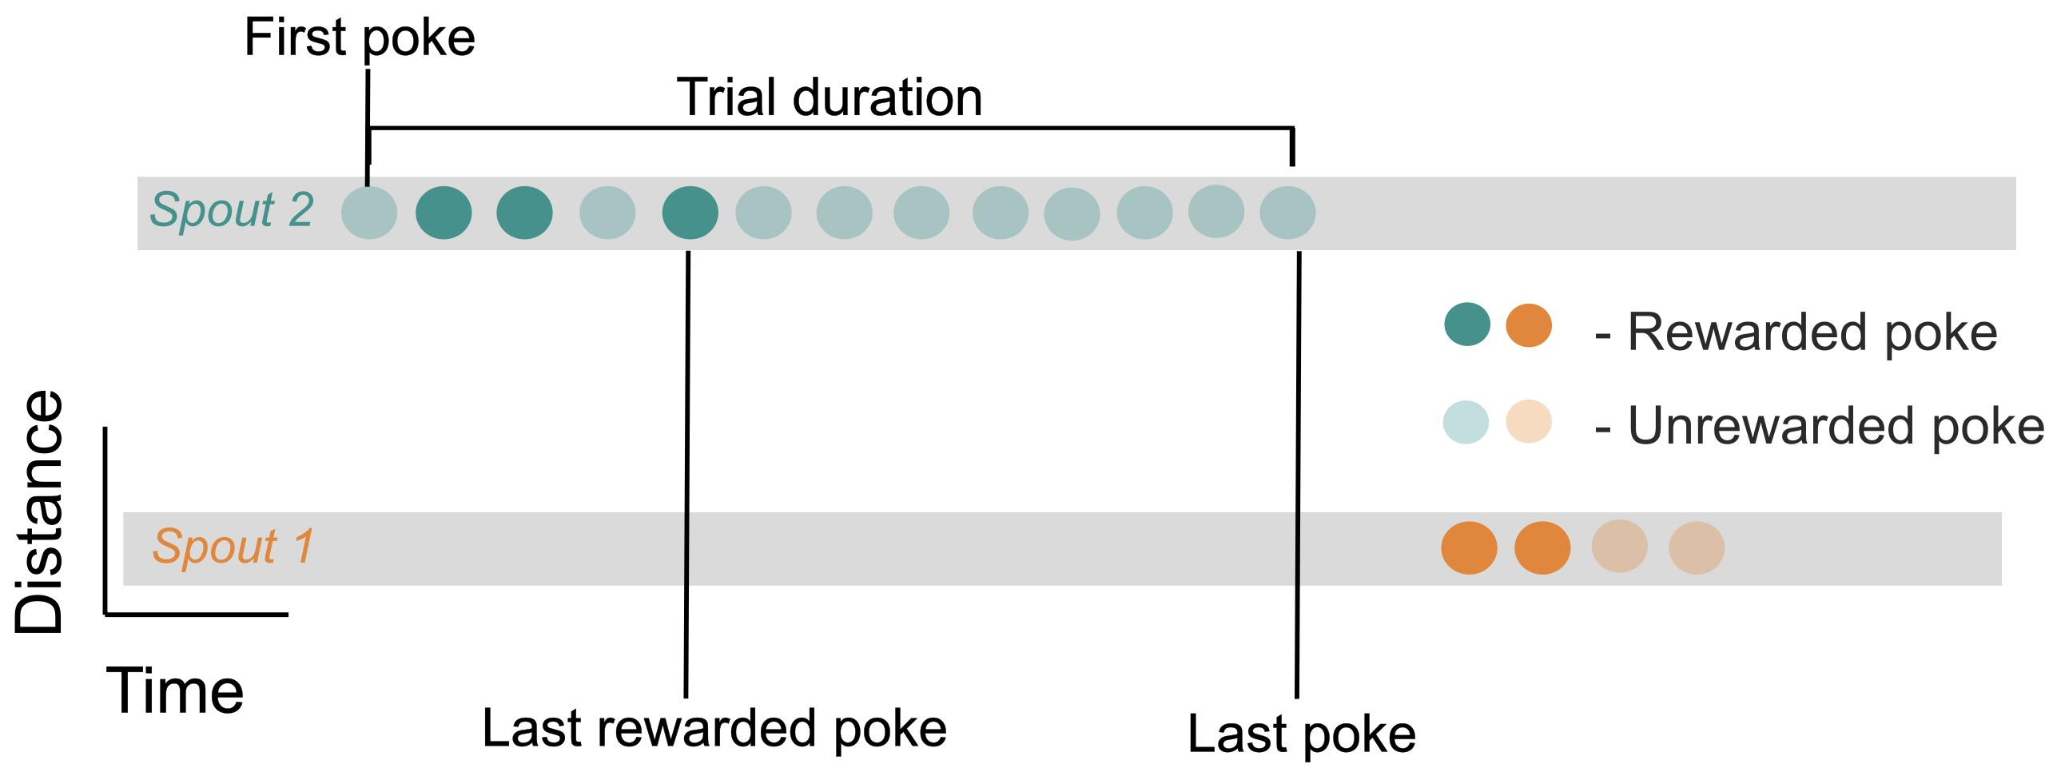
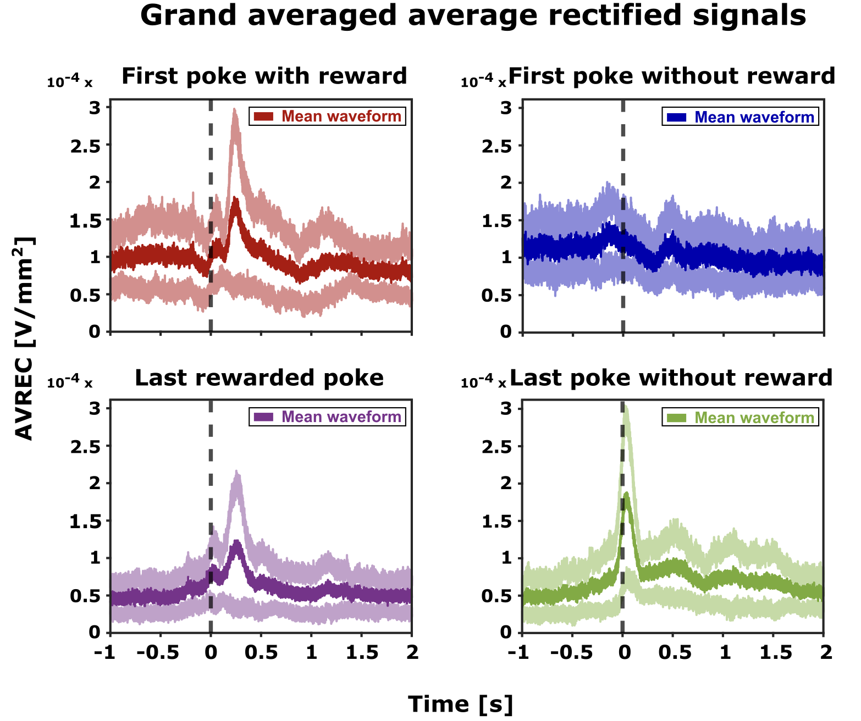
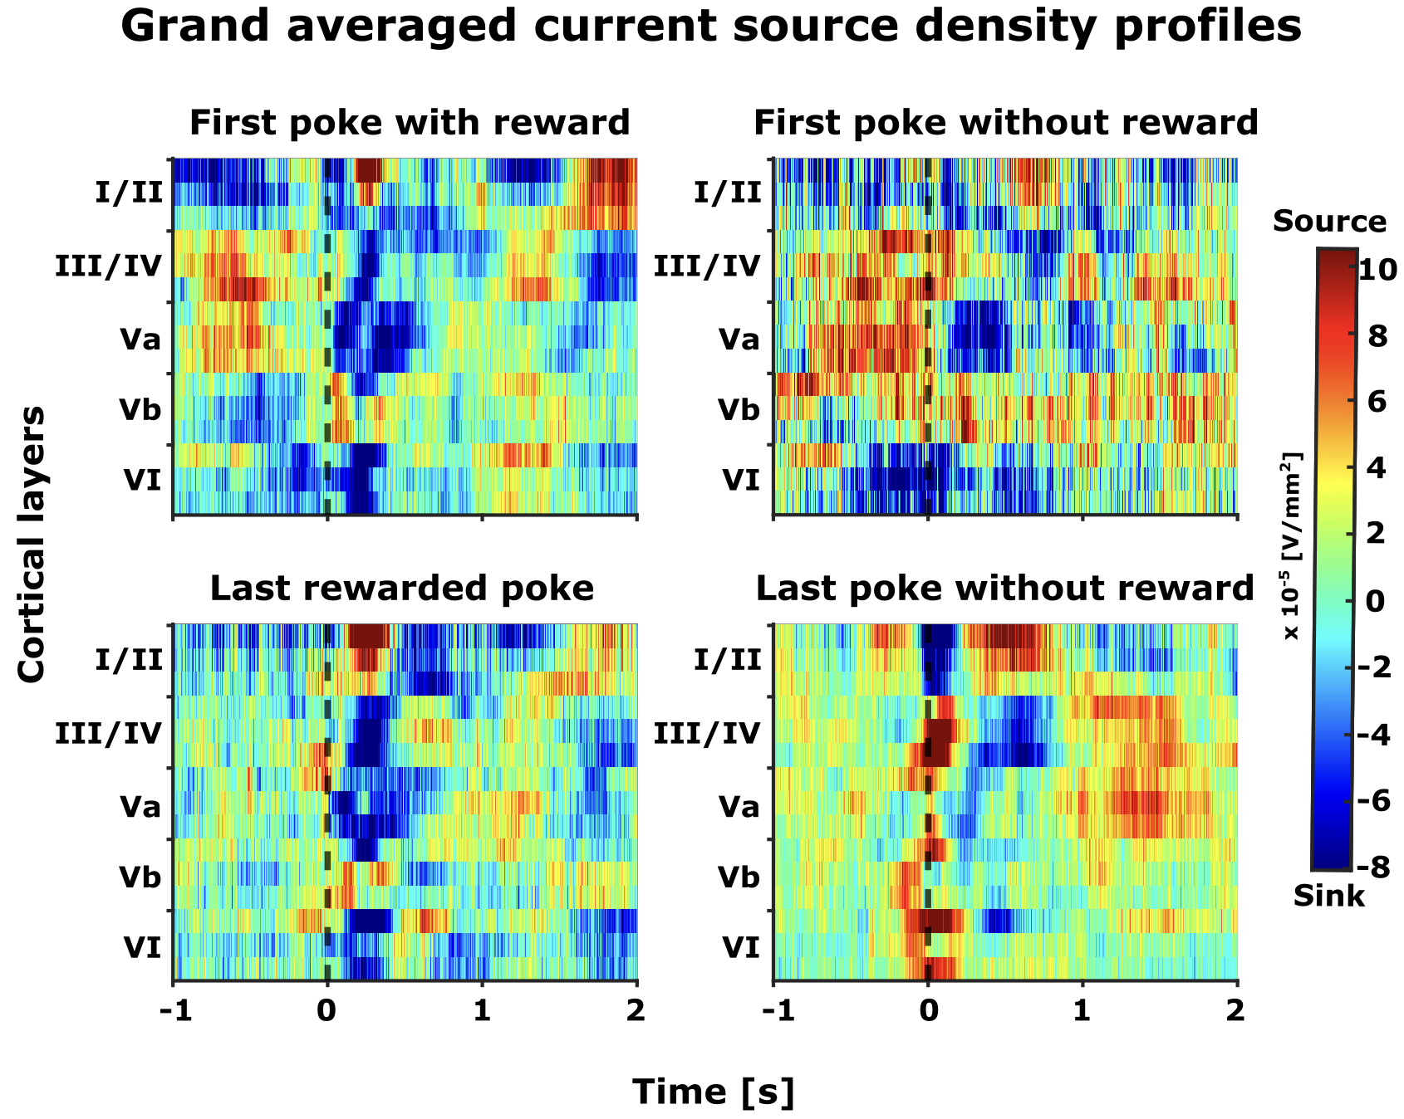
FrA encodes expectation and evaluation of reward
Current source density analysis
Epochs of interest
Rewarded
Unrewarded
First poke
First poke
Exploitation
Shift towards exploration
Exploration
Last rewarded poke
Last poke
Average across layers
Overall frontal activity
Does the Frontal region A (FrA) represent animal’s behaviour?
Frontal activity
Distinct spatiotemporal profile

Slide 21
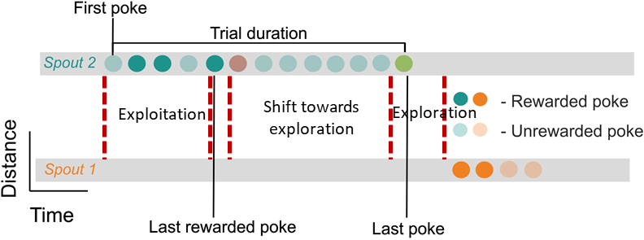
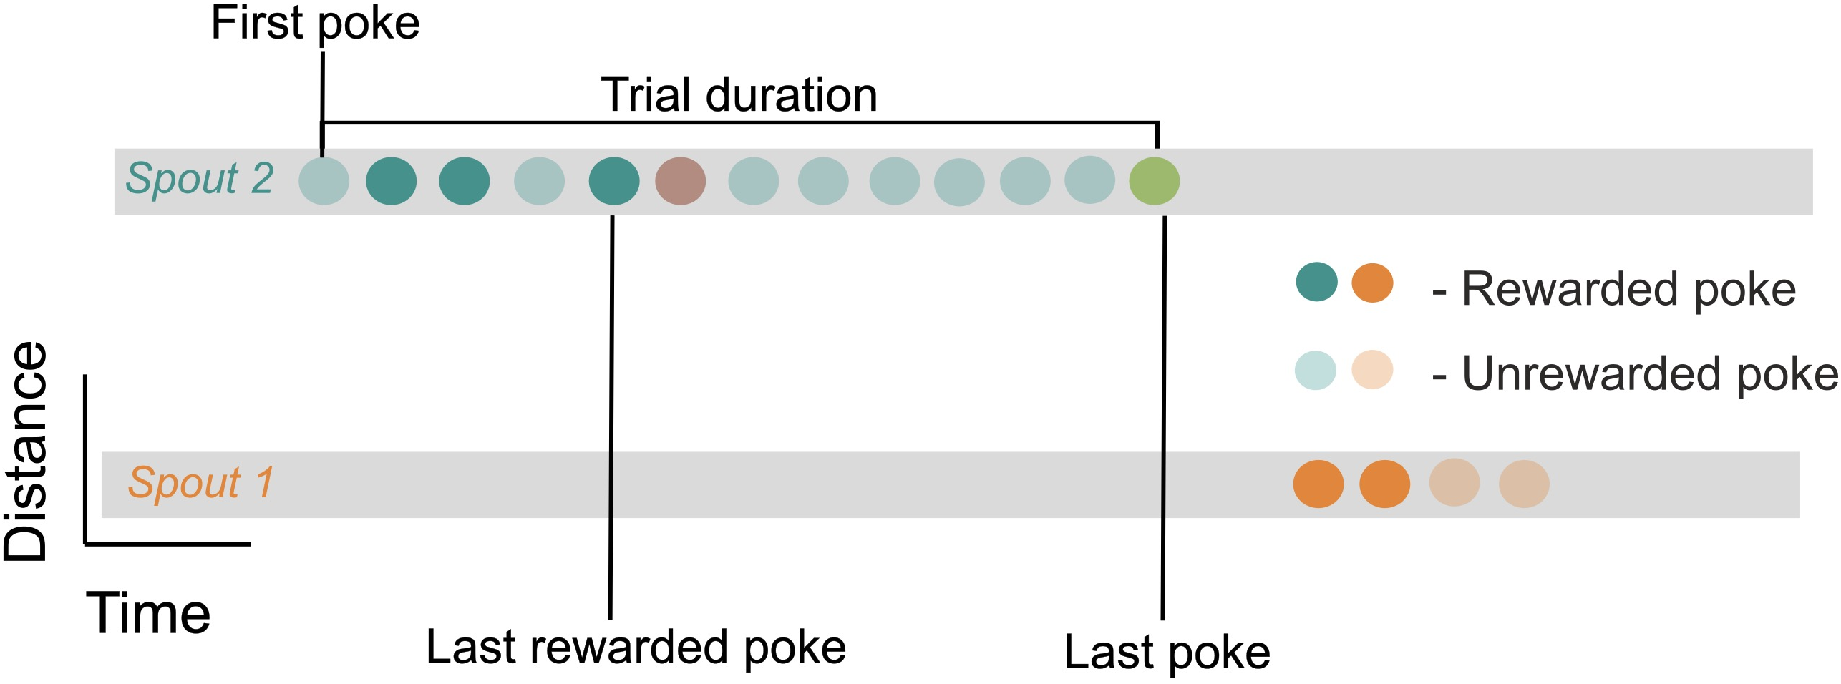
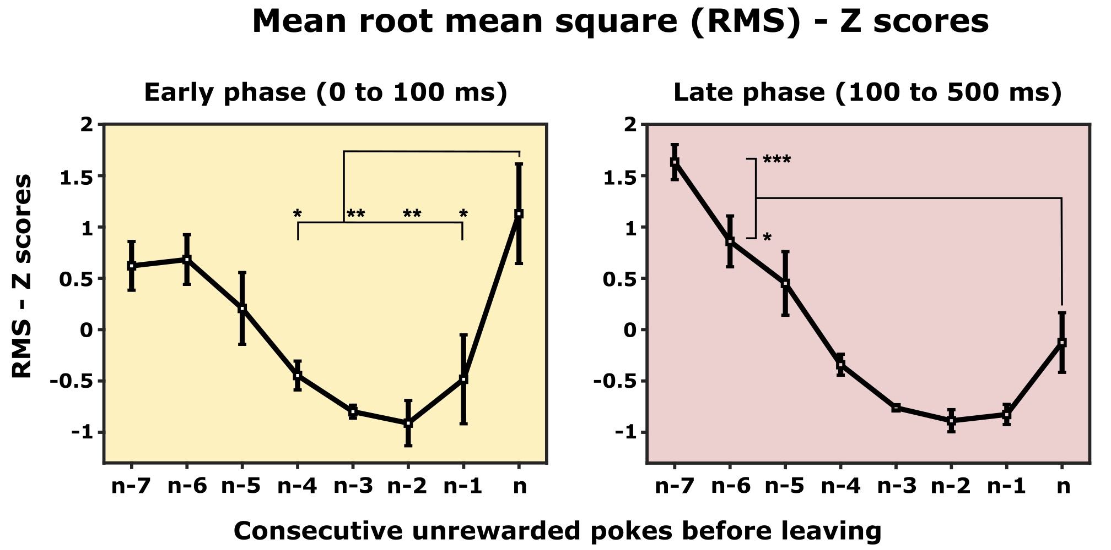
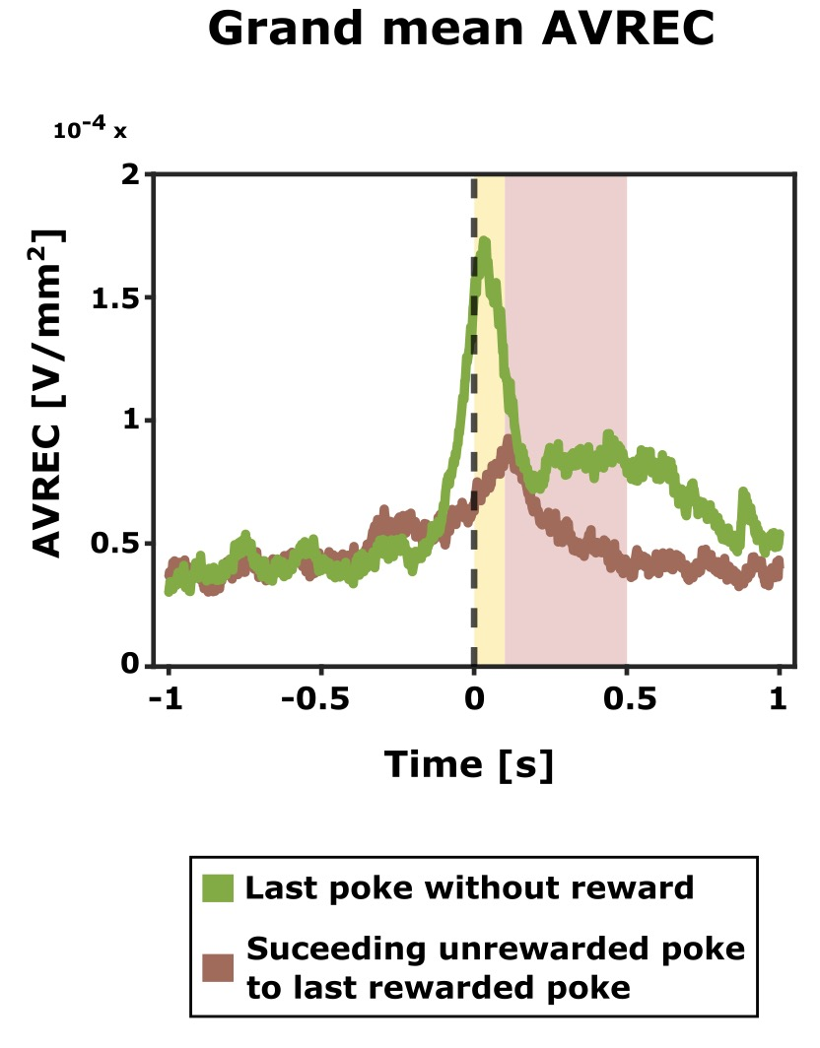
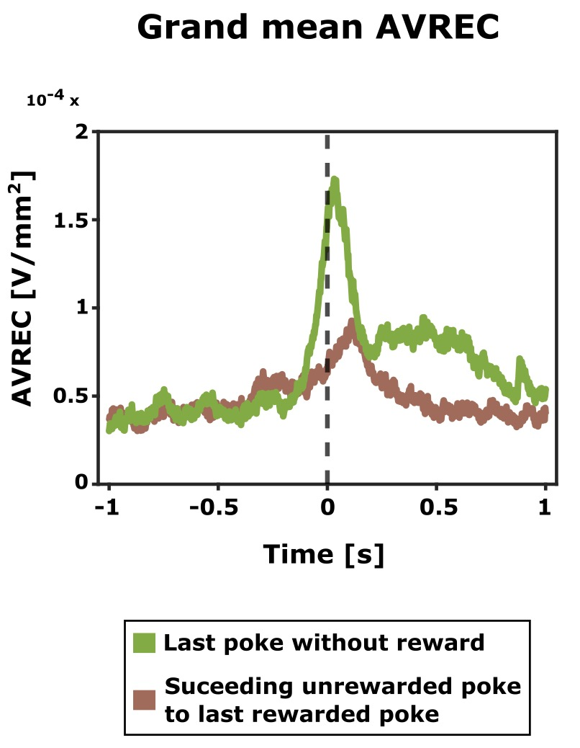

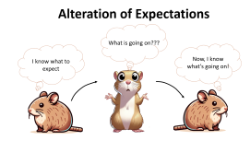

Shifts in frontal activity patterns: Exploitation to exploration
What makes the last poke the last one?
Exploitation
Shift towards exploration
Exploration
Individual poke RMS
Early phase – 0 to 100 ms after the end of the poke
Late phase – 100- 500 ms after the end of the poke
Notes:
Why in the late phase the RMS of nth poke is lower than n-7 when the waveform show otherwise? The trials for n-7 is way lesser compared to the trials for nth poke. Denominator of the RMS is large for nth poke. On the other hand, even if amidst this trial mismatch, the nth poke showed a huge spike in RMS in the early phase.

Slide 22

Alteration of Expectations
What is going on???
I know what to expect
Now, I know what’s going on!
Notes:
Why in the late phase the RMS of nth poke is lower than n-7 when the waveform show otherwise? The trials for n-7 is way lesser compared to the trials for nth poke. Denominator of the RMS is large for nth poke. On the other hand, even if amidst this trial mismatch, the nth poke showed a huge spike in RMS in the early phase.

Slide 23


Shifts in frontal activity patterns: Exploitation to exploration
Alteration of expectations
Poke = reward
Poke = no reward
Exploitation
Exploration
Individual poke RMS
Poke = ??
Last rewarded poke
Last poke
Notes:
Why in the late phase the RMS of nth poke is lower than n-7 when the waveform show otherwise? The trials for n-7 is way lesser compared to the trials for nth poke. Denominator of the RMS is large for nth poke. On the other hand, even if amidst this trial mismatch, the nth poke showed a huge spike in RMS in the early phase.

Slide 24
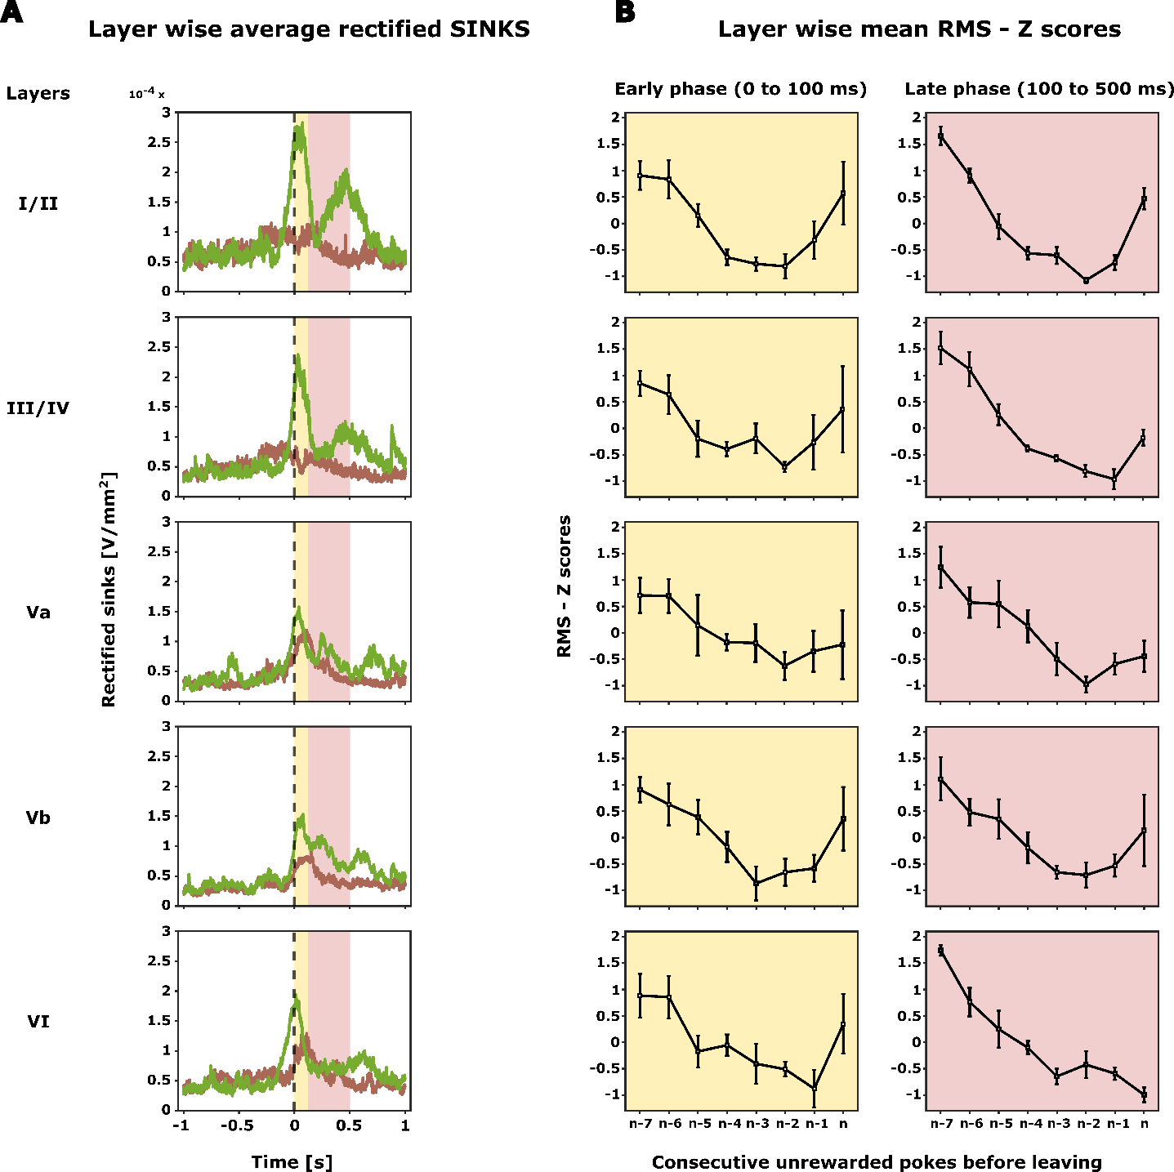

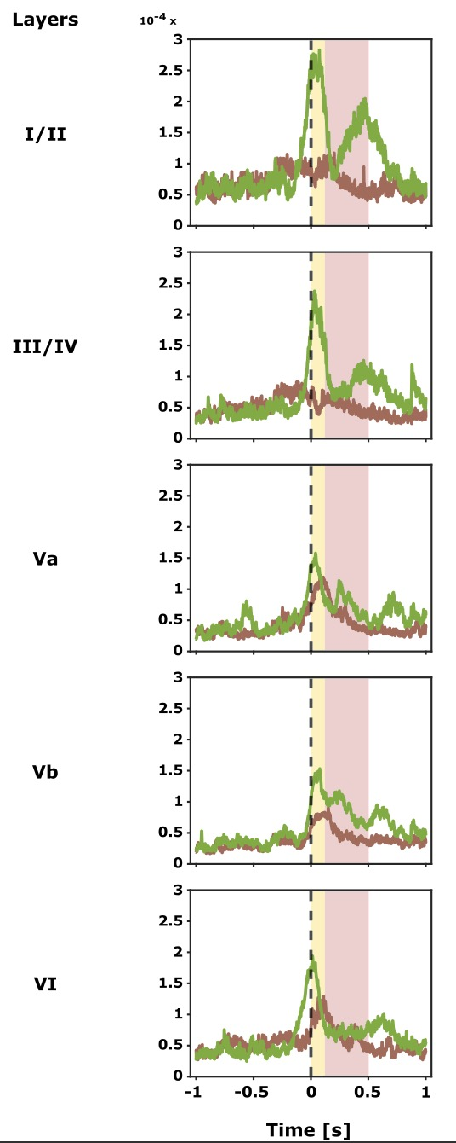
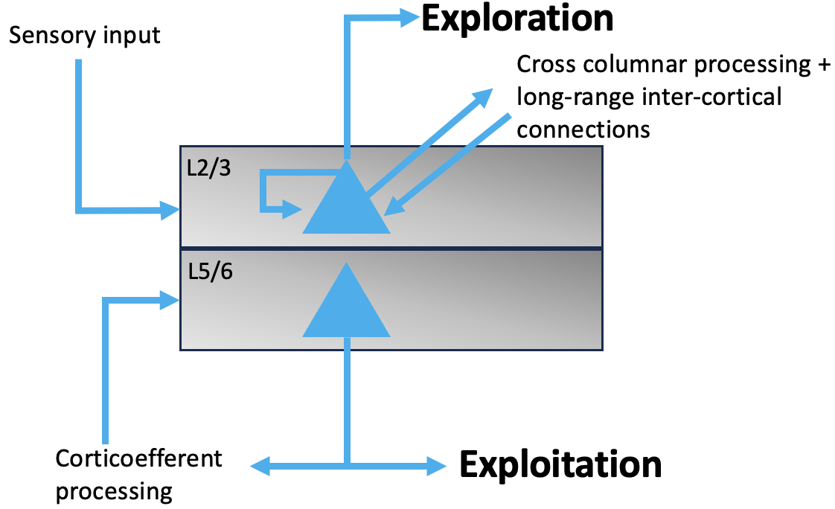
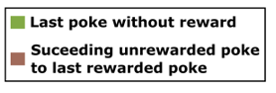
Shifts in layer specific activity patterns: Exploitation to exploration
Overall frontal activity
Individual poke RMS
1. Shift from deeper to upper layers
Early phase – 0 to 100 ms after the end of the poke
Late phase – 100- 500 ms after the end of the poke
2. During the phase of switching from exploitation to exploration, initially, activity decreases in all cortical layers.
3. At the beginning of exploration, the activity in layer I/II and III/IV increases in the early phase.
Hypothesis
Superficial layers → Exploration
Deeper layers → Exploitation
(Douglas and Martin, 2007; Godlove et al., 2014)
Notes:
Translaminar processing principles in the frontal cortex share certain common principles with the canonical cortical activation patterns (Douglas and Martin, 2007; Godlove et al., 2014).

Slide 25
Shifts in layer specific activity patterns: Exploitation to exploration
1. Shift from deeper to upper layers
2. During the phase of switching from exploitation to exploration, initially, activity decreases in all cortical layers.
3. At the beginning of exploration, the activity in layer I/II and III/IV increases in the early phase.
(Douglas and Martin, 2007; Godlove et al., 2014)

Slide 26
Shifts in layer specific activity patterns: Exploitation to exploration
1. Shift from deeper to upper layers
2. During the phase of switching from exploitation to exploration, initially, activity decreases in all cortical layers.
3. At the beginning of exploration, the activity in layer I/II and III/IV increases in the early phase.
(Douglas and Martin, 2007; Godlove et al., 2014)

Slide 27
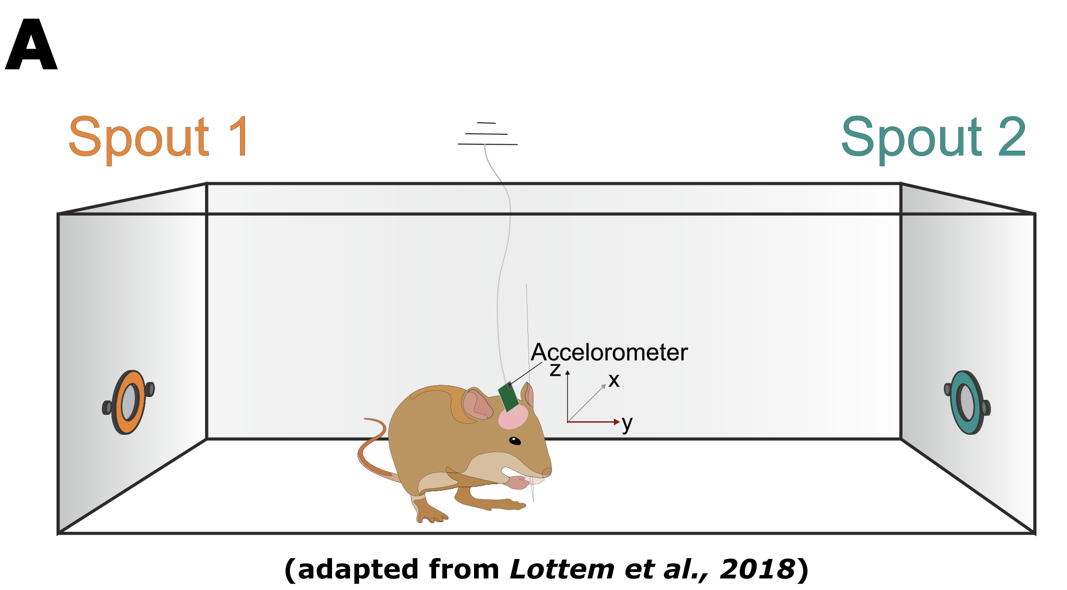
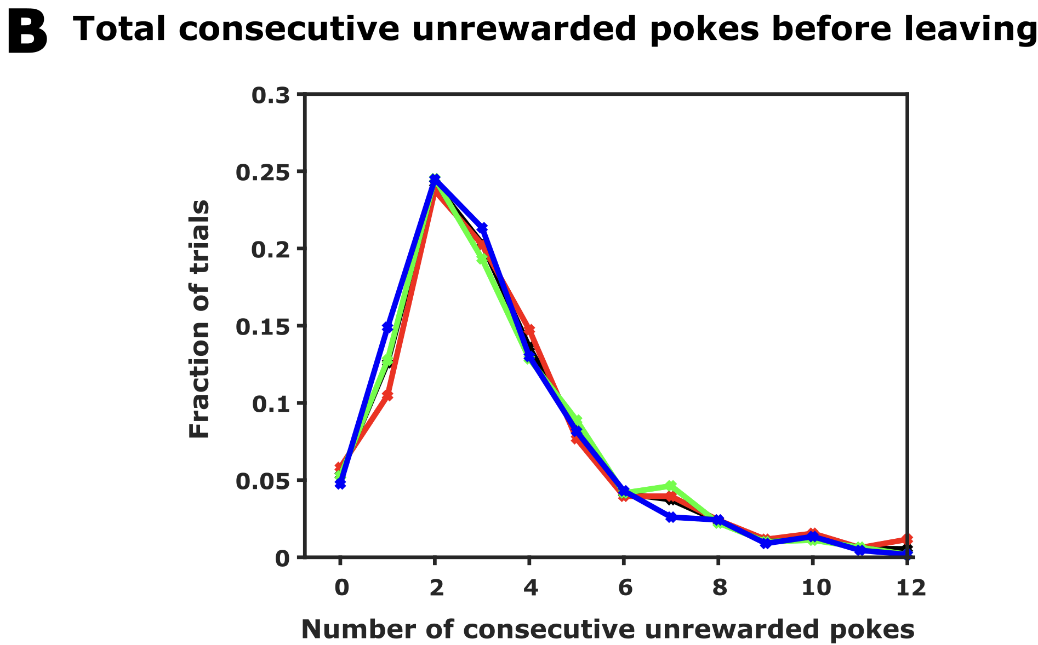
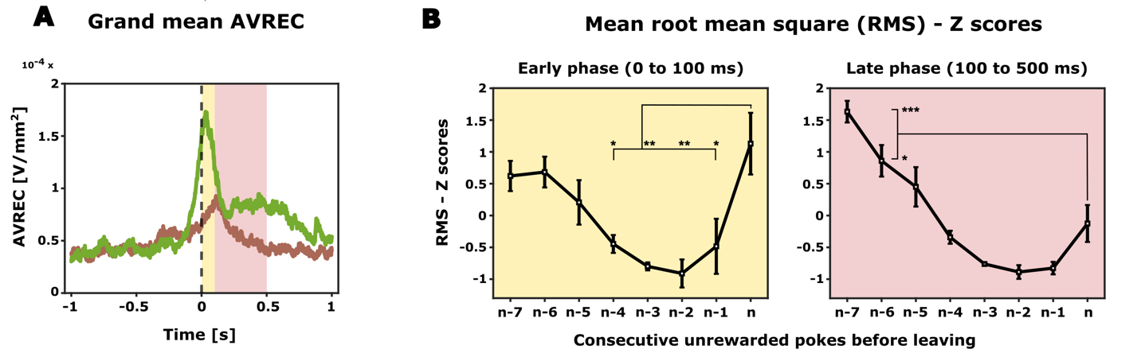
Summary
Behavioural paradigm
Optimal behaviour
Overall frontal activity
Layer-dependent processing
Probabilistic foraging
Animals form inference about hidden probabilities
Increase in overall frontal activity just before the animal decides to explore
Decisive role by altering current expectation and adopting adequate search strategies
Inference-based decision making
Role of frontal cortex in exploration/exploitation dilemma and attentional resource allocation.

Slide 28
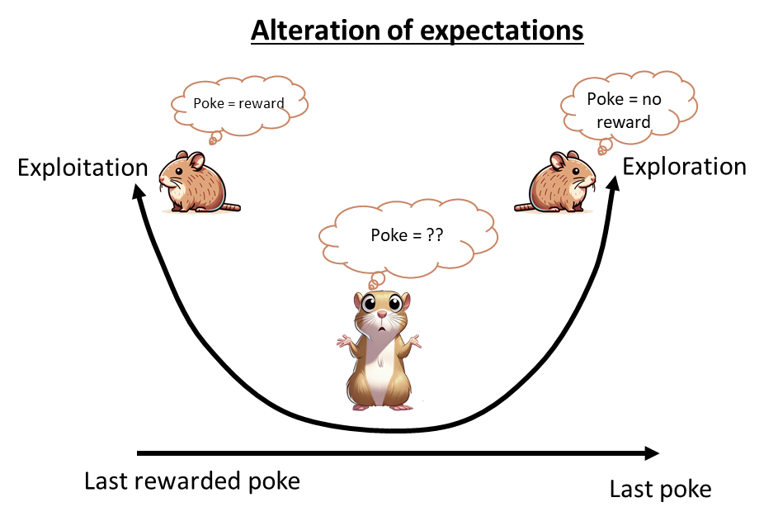
Summary and conclusion
Probabilistic foraging
Frontal region A (FrA)
Overall frontal activity
Layer-dependent processing
FrA encodes expectation and evaluation of reward
Increase in overall frontal activity just before the animal decides to explore
Decisive role by altering current expectation and adopting adequate search strategies
Optimal behaviour
Animals value reward and no reward differently
Distinct spatiotemporal activity that varies based on the animal’s behaviour
Inference-based decision making
Notes:
This thesis has delved into the neural underpinnings of decision-making under uncertainty, with a focus on the dynamic role of the frontal region A (FrA) in gerbils.
In our probabilistic foraging paradigm, the gerbils demonstrated not a reliance on fixed foraging patterns, but rather an advanced, inference-based decision-making process informed by their experiences.
The complex neural activity within the FrA, depicting reward anticipation and evaluation, highlights a cognitive process where past learning is intricately merged with immediate situational assessments.
Pre-decisional increase in frontal activity. Alteration of expectations through evidence accumulation.
Furthermore, our investigation into layer-specific neural activity in the FrA revealed a sophisticated, layer-dependent processing mechanism. This is crucial for the adaptation of search strategies during foraging and reflects the nuanced way the brain can dynamically allocate attentional resources.

Slide 29
Perspectives
Reinforcement learning based behavioural modeling - emergence of optimal behaviour
Spectral analysis – inter-layer frequency coupling
Optogenetic intervention – meso-frontal dopamine micro-circuit?
Comparative foraging task in humans using high-field fMRI – layer specific analysis
Notes:
Ultimately, by bridging animal behavior with human cognitive science, this study lays the groundwork for future research into the complex neural underpinnings of decision-making in uncertain environments. It underscores the beginning of a deeper inquiry into decision neuroscience, inviting further exploration into the vast, uncharted territories of how brains navigate decisions in the real world.

Slide 30


Acknowledgements
CortXplorer group
Prof. Max Happel
Parthiban Saravanakumar
Ebru Acun
Katrina Deane
SPL Department, LIN
Prof. Frank Ohl
PD Dr. Maike Vollmer
Ms. Beate Traore
Institut für Psychologie, OVGU
Prof. Dr. Stefan Pollmann
Lasse Güldener
Friends and family

Slide 31

Thank you
?
Questions

Slide 32
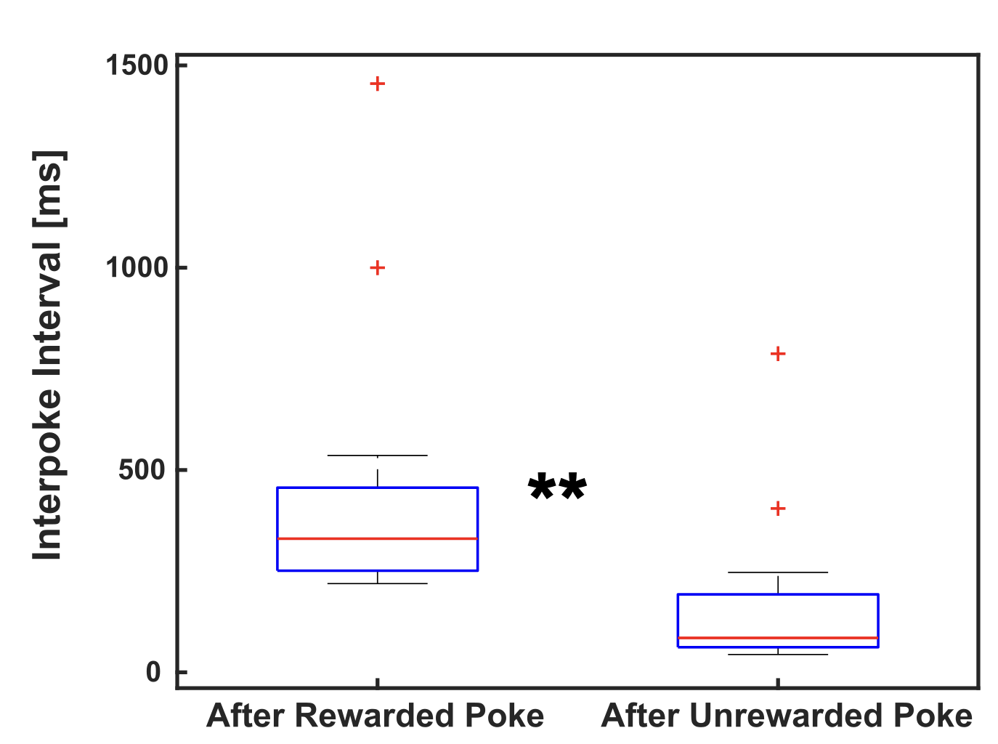
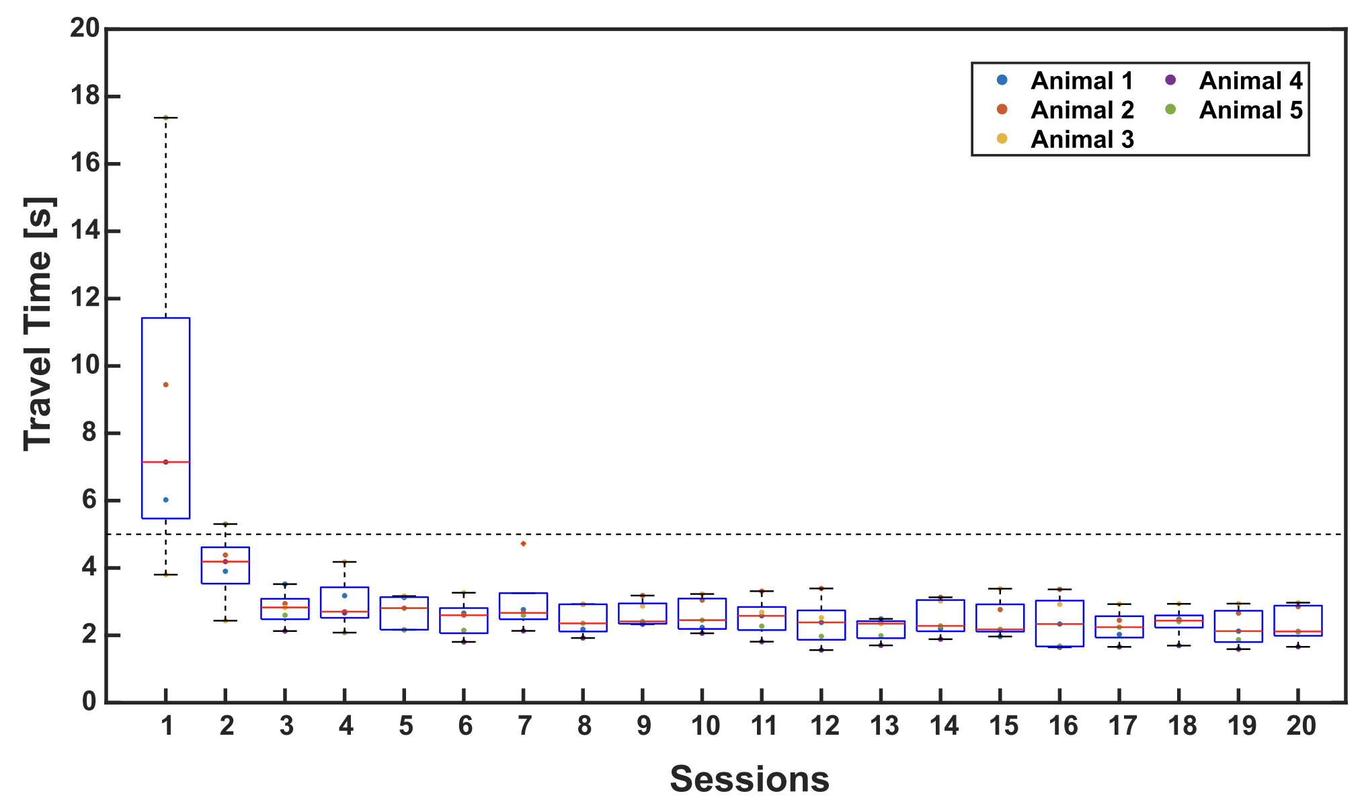
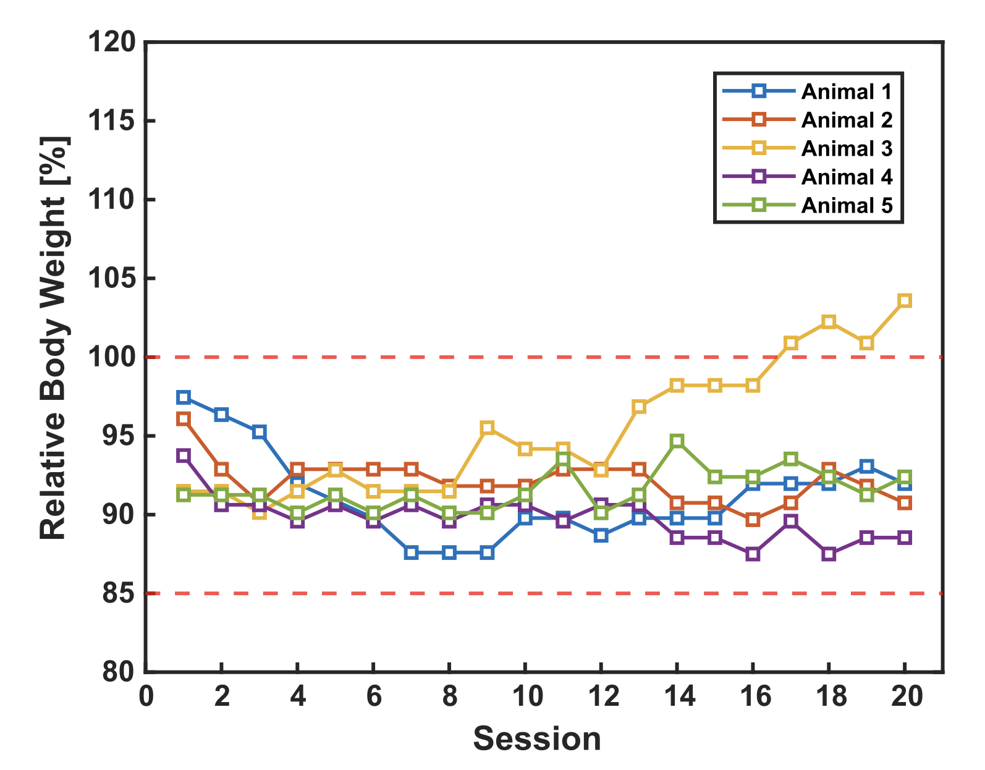
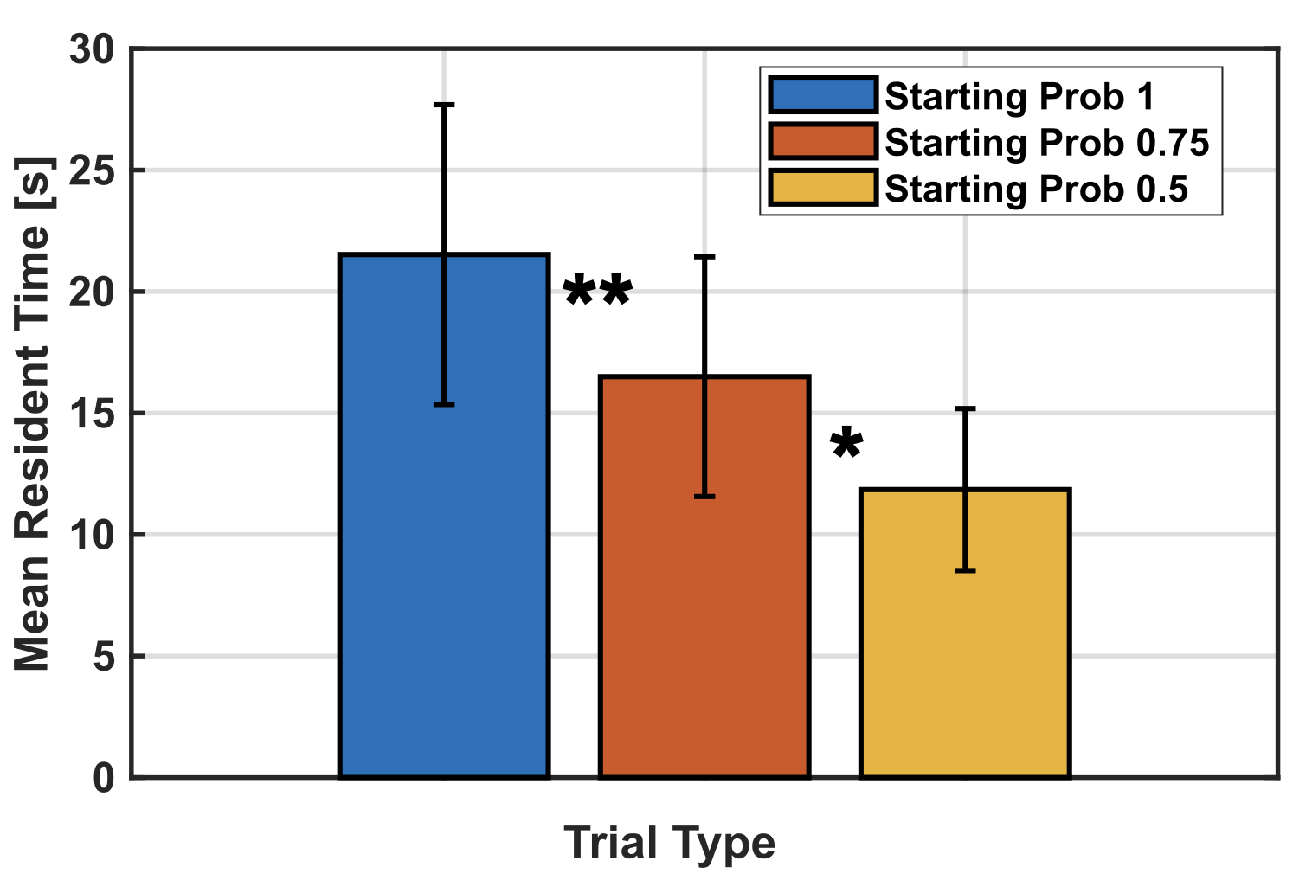
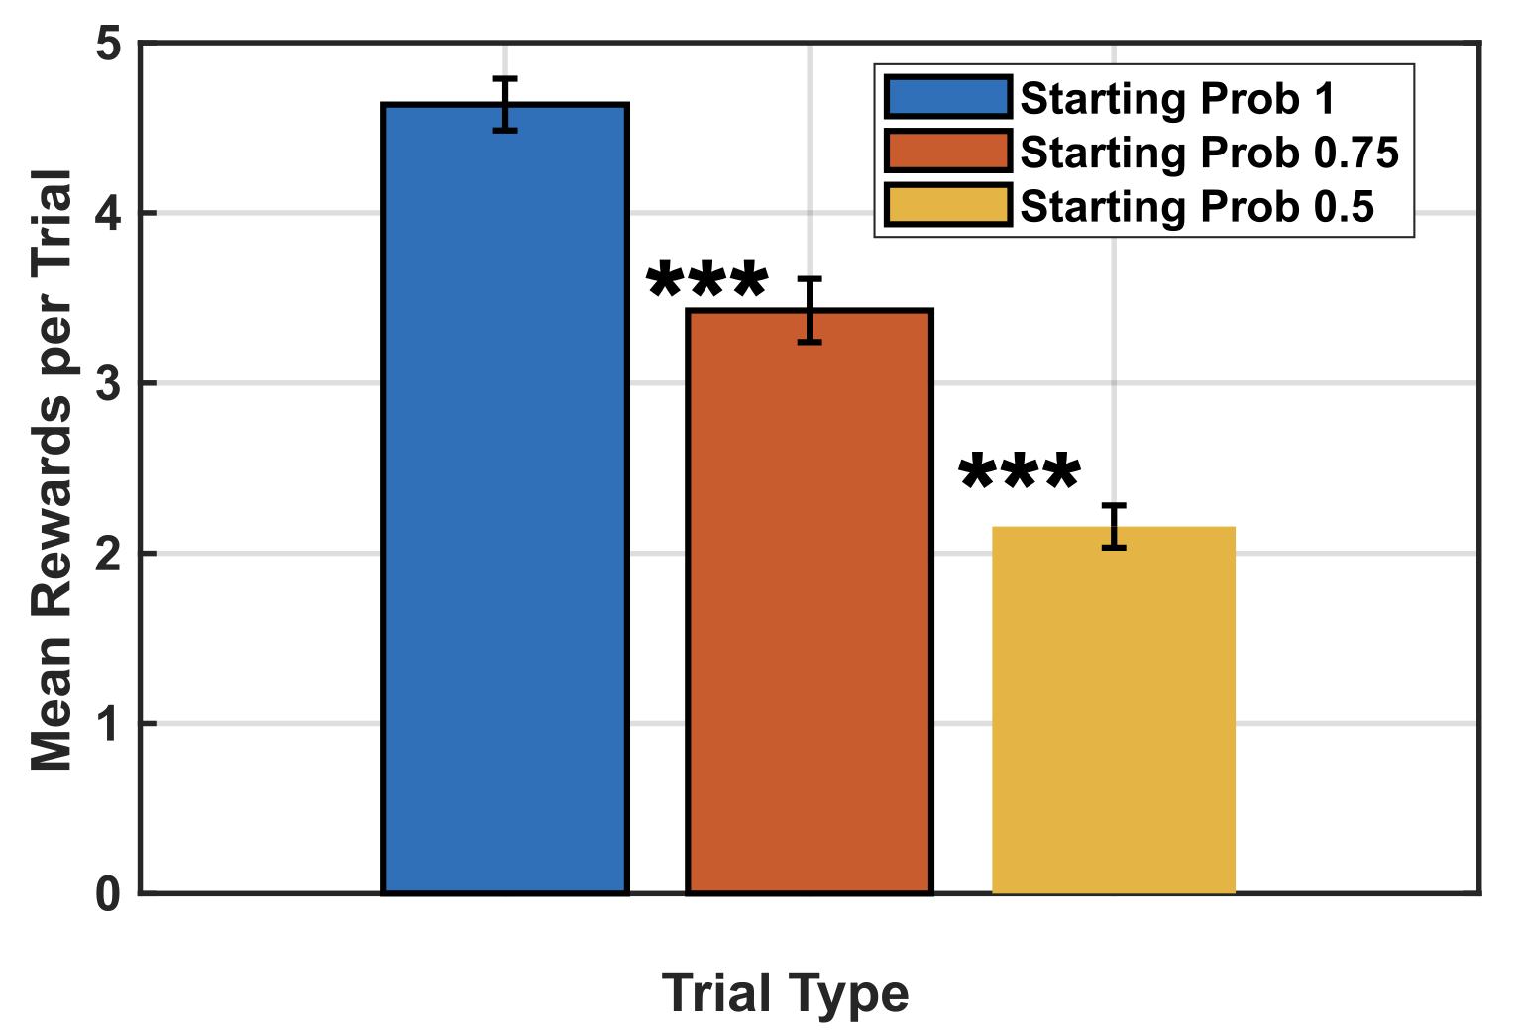
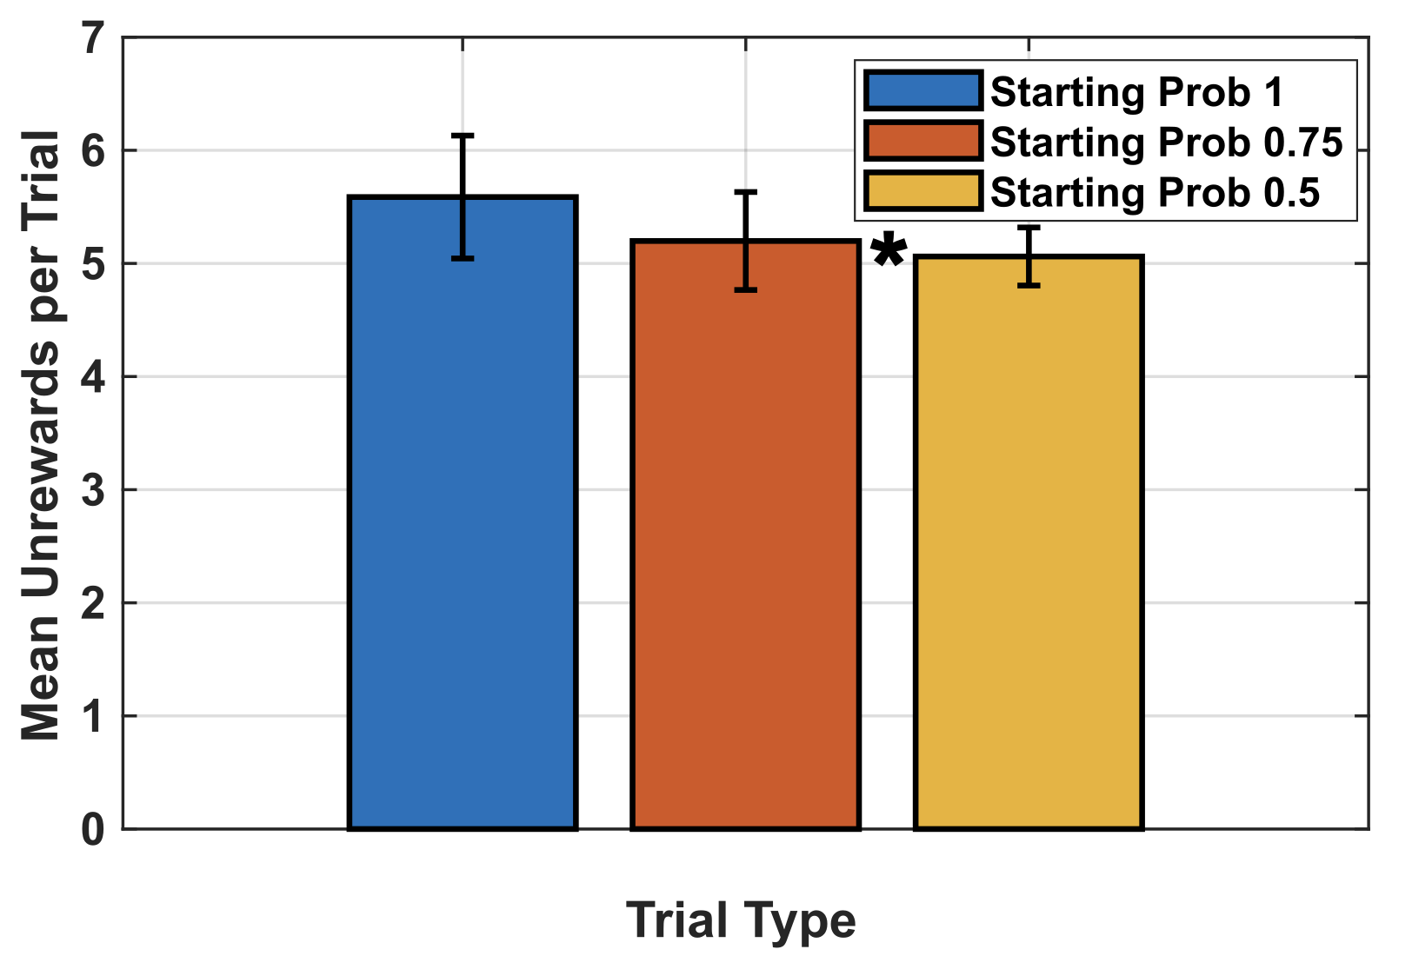
Behavioural results
Travel time across sessions
Inter-poke Interval
Relative Body weight
Resident Time
Rewarded pokes per trial type
Unrewarded pokes per trial type
Notes:
Add also total no.of pokes in each trial type.

Slide 33
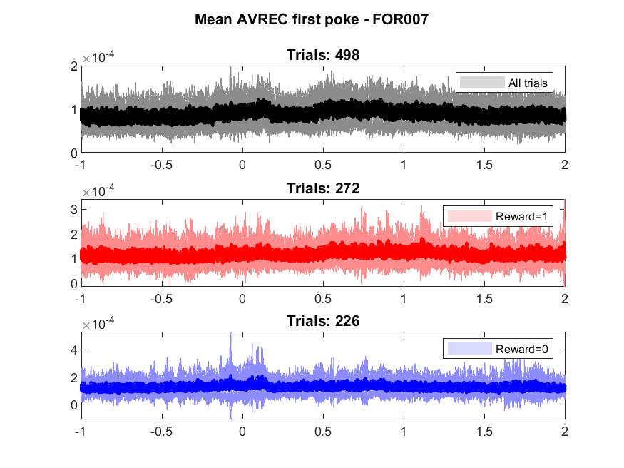

Signal from first four animals
(4.00 mm from bregma)

Slide 34










Layer-wise rectified sinks for rewarded pokes

Slide 35


Slide 36

Exploration
Sensory input
Cross columnar processing + long-range inter-cortical connections
L2/3
L5/6
Corticoefferent processing
Exploitation

Slide 37




Prefrontal cortex and exploratory decision-making
Neural substrates for exploratory behaviour
Frontopolar cortex in humans – Gambling studies (Daw et al., 2006 ) (Raja Beharelle et al., 2015)
aPFC in Monkeys (Mansouri et al., 2015)
Our Study
Rodent model – Mongolian gerbils (Desert rodents)
The Situation
Radtke-Schuller et al., 2016
Frontal region A (FrA) – analogous to Frontopolar cortex in humans
Exploitation
Exploration
(Shuai and Song, 2011)
Notes:
We often must choose whether to try something new (exploration) or stick with a proven strategy (exploitation). Balancing this trade-off is important for survival and growth across species because, without exploration, we would perseverate with the same strategies and never discover better options. Which brain mechanisms are responsible for our ability to make these decisions?
Humans are remarkably curious, and that is useful in helping us to learn about new environments and possibilities. But curiosity killed the cat, they say, and it also carries with it substantial potential risks and costs for us. Statisticians, engineers and economists have long considered ways of balancing the costs and benefits of exploration.

Slide 38
Future directions
Reinforcement Learning Modeling can help to investigate the trial-by-trial parameters, that underlie animal's inference-bound adaptive decision-making behavior, providing insights into the neural circuitry of attentional resource allocation
Optogenetic intervention to understand the causal relationship
In a comparative foraging task in humans using high-field fMRI, we plan to observe if similar layer-specific functions during exploration/exploitation transitions can be demonstrated.

Slide 39


Frontal Activity
Circuit Analysis
Exploitation
Exploration
I/II
Supragranular
layers
III/IV
Exploration
Exploitation
Va
Vb
Infragranular
layers
VI

Slide 40

The curve of expectations
Poke = reward
Poke = no reward
Exploitation
Exploration
What should I expect?
Last rewarded poke
Last poke

Slide 41




Signal from motor cortex
(4mm from bregma, motor cortex)
(4.65mm from bregma)

